Slide 1
AODA COMPLIANCE – WEBSITE ACCESSIBILITY WORKSHOP
Presented by: Vee Saraf

Slide 2
ACCESSIBILITY FOR ONTARIANS WITH DISABILITIES ACT, (AODA) 2005
The AODA was passed in Ontario in 2005. Its vision was, and still is, to make Ontario accessible by 2025. So far, it encompasses 5 main areas: Customer Service, Employment, Transportation, Information Communication and Built Environment.
In 2011, the Ministry released the Integrated Accessibility Standard Regulation (IASR)
Accessibility Standards for Customer Service
Integrated Accessibility Standards Regulation (IASR)
Part 1: Employment
Part 2: Information and Communications
Section 14: Accessible websites and web content
Part 3: Transportation
Part 4: Design of Public Spaces
Within the IASR, Section 14 governs an organization’s obligations for their websites.

Slide 3
INTEGRATED ACCESSIBILITY STANDARDS REGULATION - EXCERPT
SECTION #14: ACCESSIBLE WEBSITES AND WEB CONTENT
The Government of Ontario and the Legislative Assembly, for both their internet and intranet sites, shall meet the requirements in this section in accordance with the following schedule:
By January 1, 2012: New internet and intranet websites and web content on those sites must conform to WCAG 2.0 Level AA, other than:
Success criteria 1.2.4 Captions (Live), and
Success criteria 1.2.5 Audio Descriptions (Pre-recorded).
By January 1, 2016: All internet websites and web content must conform to WCAG 2.0 Level AA other than:
Success criteria 1.2.4 Captions (Live), and
Success criteria 1.2.5 Audio Descriptions (Pre-recorded).
By January 1, 2020: All internet and intranet websites and web content must conform to WCAG 2.0 Level AA.

Slide 4
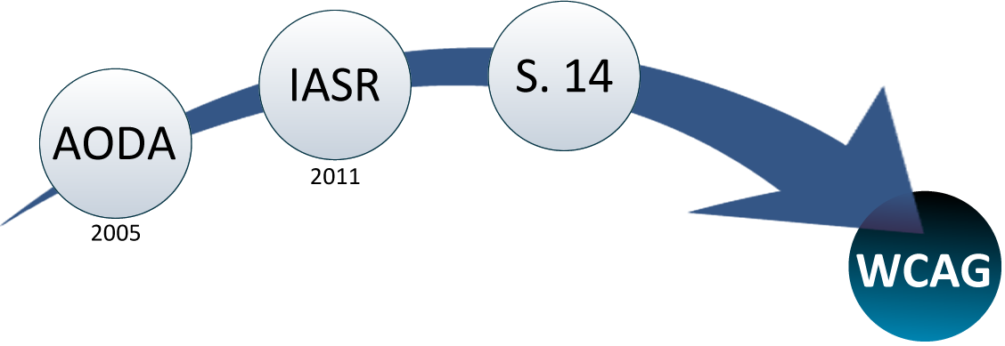
WEB CONTENT ACCESSIBILITY
GUIDELINES (WCAG) 2.0

Slide 5
WHAT IS WCAG?
First introduced as version 1.0 in 1999, and the current WCAG 2.0 standard was released in 2008.
The Web Content Accessibility Guidelines are typically referred to by their acronym WCAG (pronounced "wick-ag"). It’s a series of guidelines created by the World Wide Web Consortium (W3C) in order to improve website accessibility.
Following these guidelines will make content accessible to a wider range of people with disabilities, including blindness and low vision, deafness and hearing loss, learning disabilities, cognitive limitations, limited movement, speech disabilities, photosensitivity and combinations of these.

Slide 6

WCAG 2.0 LAYERS OF GUIDANCE
Principles - At the top are 4 principles that provide the foundation for Web accessibility: perceivable, operable, understandable, and robust.
Guidelines - Under the principles are guidelines. The 12 guidelines provide the basic goals that authors should work toward in order to make content more accessible to users with different disabilities. The guidelines are not testable, but provide the framework and overall objectives to help authors understand the success criteria and better implement the techniques.
Success Criteria - For each guideline, testable success criteria are provided to allow WCAG 2.0 to be used where requirements and conformance testing are necessary such as in design specification, purchasing, regulation, and contractual agreements. In order to meet the needs of different groups and different situations, three levels of conformance are defined: A (lowest), AA, and AAA (highest).

Slide 7
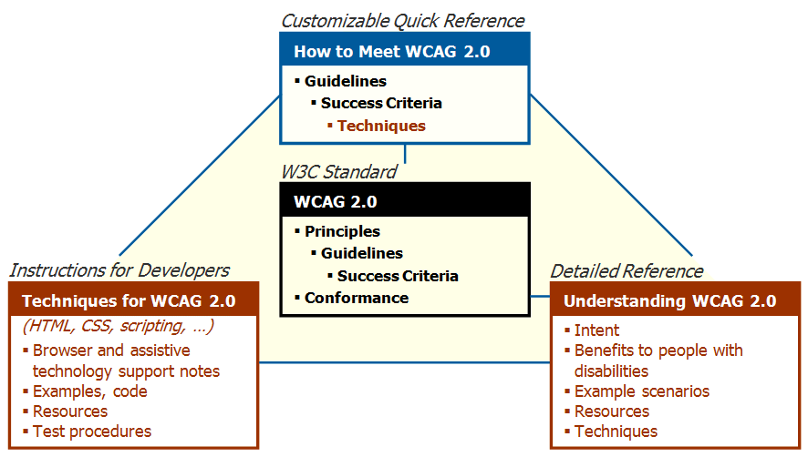
THE WCAG 2.0 DOCUMENTS

Slide 8
WCAG 2.0: A CLOSER LOOK (1)
THE PRINCIPLES
Perceivable - Information and user interface must be presented to users in ways they can perceive.
Operable - Users must be able to use the interface. It cannot require interaction that a user cannot perform.
Understandable - Users must be able to understand the information as well as how to use the interface.
Robust – Users must be able to access the content as technologies advance. In other words, as technologies and user agents evolve, the content should remain accessible.

Slide 9
WCAG 2.0: A CLOSER LOOK (2)
THE GUIDELINES
Text Alternatives: Provide text alternatives for any non-text content
Time-based Media: Provide alternatives for Video and Audio content.
Adaptable: Create content that can be presented in different ways (for example simpler layout) without losing information or structure.
Distinguishable: Make it easier for users to see and hear content including a separation of foreground from background.
Keyboard Accessible: Make all functionality available from a keyboard.
Enough Time: Provide users enough time to read and use content.
Seizures and Physical Reactions: Do not design content in a way that is known to cause seizures or physical reactions.
Navigable: Provide ways to help users navigate, find content, and determine where they are.
(cont.)

Slide 10
WCAG 2.0: A CLOSER LOOK (3)
THE GUIDELINES (cont.)
Input Modalities: Make it easier for users to operate functionality through various inputs beyond keyboard.
Readable: Make text content readable and understandable.
Predictable: Make Web pages appear and operate in predictable ways.
Input Assistance: Help users avoid and correct mistakes.
Compatible: Maximize compatibility with current and future user agents

Slide 11
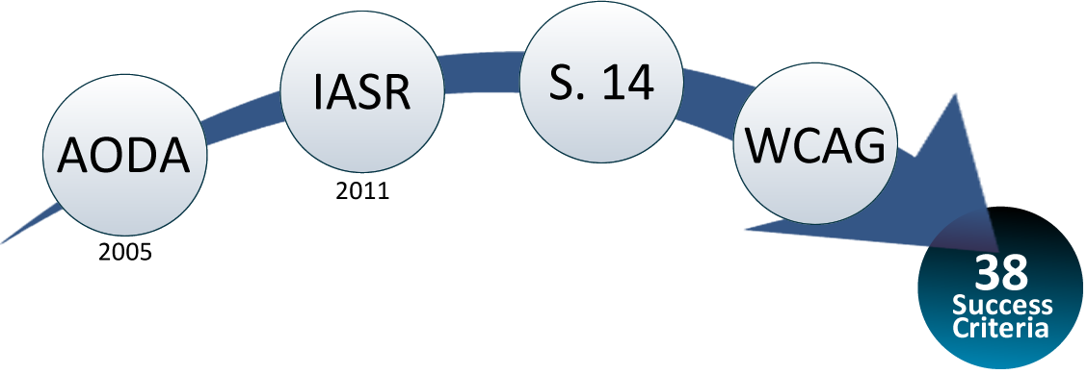
WCAG 2.0: A CLOSER LOOK (4)
SUCCESS CRITERIA
WCAG 2.0 success criteria are written as testable statements that are not technology-specific. All Success Criteria are important access issues for people with disabilities.
Each is assigned a conformance level taking into consideration a wide range of interacting issues. There are 38 Level A and Level AA Success Criteria. AODA compliance, with regards to obligations for websites, is essentially meeting those 38 criteria.

Slide 12
1 PERCEIVABLE

Slide 13
1.1 TEXT ALTERNATIVES (1)
1.1.1 Non-text Content (Level A) Understanding this Criterion
All non-text content that is presented to the user has a text alternative that serves the equivalent purpose, except for the situations listed below.
Controls, Input: If non-text content is a control or accepts user input, then it has a name that describes its purpose.
Time-Based Media: If non-text content is time-based media, then text alternatives at least provide descriptive identification of the non-text content.
Test: If non-text content is a test or exercise that would be invalid if presented in text, then text alternatives at least provide descriptive identification of the non-text content.
Sensory: If non-text content is primarily intended to create a specific sensory experience, then text alternatives at least provide descriptive identification of the non-text content.

Slide 14
1.1 TEXT ALTERNATIVES (2)
CAPTCHA: If the purpose of non-text content is to confirm that content is being accessed by a person rather than a computer, then text alternatives that identify and describe the purpose of the non-text content are provided, and alternative forms of CAPTCHA using output modes for different types of sensory perception are provided to accommodate different disabilities.
Decoration, Formatting, Invisible: If non-text content is pure decoration, is used only for visual formatting, or is not presented to users, then it is implemented in a way that it can be ignored by assistive technology.

Slide 15
1.2 TIME-BASED MEDIA (1)
1.2.1 Audio-only and Video-only Understanding this Criterion (Prerecorded)(Level A)
For prerecorded audio-only and prerecorded video-only media, the following are true, except when the audio or video is a media alternative for text and is clearly labeled as such:
Prerecorded Audio-only: An alternative for time-based media is provided that presents equivalent information for prerecorded audio-only content.
Prerecorded Video-only: Either an alternative for time-based media or an audio track is provided that presents equivalent information for prerecorded video-only content.
1.2.2 Captions (Prerecorded) (Level A) Understanding this Criterion
Captions are provided for all prerecorded audio content in synchronized media, except when the media is a media alternative for text and is clearly labeled as such.

Slide 16
1.2 TIME-BASED MEDIA (2)
1.2.3 Audio Description or Media Alternative Understanding this Criterion (Prerecorded)(Level A)
An alternative for time-based media or audio description of the prerecorded video content is provided for synchronized media, except when the media is a media alternative for text and is clearly labeled as such.
1.2.4 Captions (Live) (Level AA) Understanding this Criterion
Captions are provided for all live audio content in synchronized media.
1.2.5 Audio Description Understanding this Criterion (Prerecorded) (Level AA)
Audio description is provided for all prerecorded video content in synchronized media.
1.2.6 Sign Language Understanding this Criterion (Prerecorded) (Level AAA)
Sign language interpretation is provided for all prerecorded audio content in synchronized media.

Slide 17
1.2 TIME-BASED MEDIA (3)
1.2.7 Extended Audio Description Understanding this Criterion (Prerecorded) (Level AAA)
Where pauses in foreground audio are insufficient to allow audio descriptions to convey the sense of the video, extended audio description is provided for all prerecorded video content in synchronized media.
1.2.8 Media Alternative Understanding this Criterion (Prerecorded) (Level AAA)
An alternative for time-based media is provided for all prerecorded synchronized media and for all prerecorded video-only media.
1.2.9 Audio-only (Live) (Level AAA) Understanding this Criterion
An alternative for time-based media that presents equivalent information for live audio-only content is provided.

Slide 18
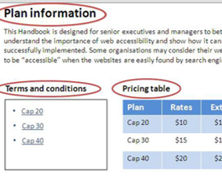
1.3 ADAPTABLE (1)
1.3.1 Info and Relationships (Level A) Understanding this Criterion
Information, structure, and relationships conveyed through presentation can be programmatically determined or are available in text.
1.3.2 Meaningful Sequence (Level A) Understanding this Criterion
When the sequence in which content is presented affects its meaning, a correct reading sequence can be programmatically determined.

Slide 19
1.3 ADAPTABLE (2)
1.3.3 Sensory Characteristics (Level A) Understanding this Criterion
Instructions provided for understanding and operating content do not rely solely on sensory characteristics of components such as shape, color, size, visual location, orientation, or sound.
1.3.4 Orientation (Level AA) Understanding this Criterion
Content does not restrict its view and operation to a single display orientation, such as portrait or landscape, unless a specific display orientation is essential.
Note: Examples where a particular display orientation may be essential are a bank check, a piano application, slides for a projector or television, or virtual reality content where binary display orientation is not applicable.

Slide 20
1.3 ADAPTABLE (3)
1.3.5 Identify Input Purpose (Level AA) Understanding this Criterion
The purpose of each input field collecting information about the user can be programmatically determined when:
The input field serves a purpose identified in the Input Purposes for User Interface Components section; and
The content is implemented using technologies with support for identifying the expected meaning for form input data.
1.3.6 Identify Purpose (Level AAA) Understanding this Criterion
In content implemented using markup languages, the purpose of User Interface Components, icons, and regions can be programmatically determined.

Slide 21
1.4 DISTINGUISHABLE (1)
1.4.1 Use of Color (Level A) Understanding this Criterion
Color is not used as the only visual means of conveying information, indicating an action, prompting a response, or distinguishing a visual element.
Note: This success criterion addresses color perception specifically. Other forms of perception are covered in Guideline 1.3 including programmatic access to color and other visual presentation coding.

Slide 22
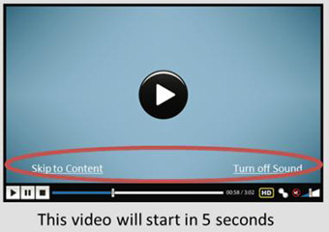
1.4 DISTINGUISHABLE (2)
1.4.2 Audio Control (Level A) Understanding this Criterion
If any audio on a Web page plays automatically for more than 3 seconds, either a mechanism is available to pause or stop the audio, or a mechanism is available to control audio volume independently from the overall system volume level.
Note: Since any content that does not meet this success criterion can interfere with a user's ability to use the whole page, all content on the Web page (whether or not it is used to meet other success criteria) must meet this success criterion. See Conformance Requirement 5: Non-Interference.

Slide 23
1.4 DISTINGUISHABLE (3)
1.4.3 Contrast (Minimum) (Level AA) Understanding this Criterion
The visual presentation of text and images of text has a contrast ratio of at least 4.5:1, except for the following:
Large Text: Large-scale text and images of large-scale text have a contrast ratio of at least 3:1;
Incidental: Text or images of text that are part of an inactive user interface component, that are pure decoration, that are not visible to anyone, or that are part of a picture that contains significant other visual content, have no contrast requirement.
Logotypes: Text that is part of a logo or brand name has no contrast requirement.

Slide 24
1.4 DISTINGUISHABLE (4)
1.4.4 Resize text (Level AA) Understanding this Criterion
Except for captions and images of text, text can be resized without assistive technology up to 200 percent without loss of content or functionality.
AAA

Slide 25
1.4 DISTINGUISHABLE (5)
1.4.5 Images of Text (Level AA) Understanding this Criterion
If the technologies being used can achieve the visual presentation, text is used to convey information rather than images of text except for the following:
Customizable: The image of text can be visually customized to the user's requirements;
Essential: A particular presentation of text is essential to the information being conveyed.
Note: Logotypes (text that is part of a logo or brand name) are considered essential.
Images of Text

Slide 26
1.4 DISTINGUISHABLE (6)
1.4.6 Contrast (Enhanced) (Level AAA) Understanding this Criterion
The visual presentation of text and images of text has a contrast ratio of at least 7:1, except for the following:
Large Text: Large-scale text and images of large-scale text have a contrast ratio of at least 4.5:1;
Incidental: Text or images of text that are part of an inactive user interface component, that are pure decoration, that are not visible to anyone, or that are part of a picture that contains significant other visual content, have no contrast requirement.
Logotypes: Text that is part of a logo or brand name has no contrast requirement.

Slide 27
1.4 DISTINGUISHABLE (7)
1.4.7 Low or No Background Audio (Level AAA) Understanding this Criterion
For prerecorded audio-only content that (1) contains primarily speech in the foreground, (2) is not an audio CAPTCHA or audio logo, and (3) is not vocalization intended to be primarily musical expression such as singing or rapping, at least one of the following is true:
No Background: The audio does not contain background sounds.
Turn Off: The background sounds can be turned off.
20 dB: The background sounds are at least 20 decibels lower than the foreground speech content, with the exception of occasional sounds that last for only one or two seconds.
Note: Per the definition of "decibel," background sound that meets this requirement will be approximately four times quieter than the foreground speech content.

Slide 28
1.4 DISTINGUISHABLE (8)
1.4.8 Visual Presentation (Level AAA) Understanding this Criterion
For the visual presentation of blocks of text, a mechanism is available to achieve the following:
Foreground and background colors can be selected by the user.
Width is no more than 80 characters or glyphs (40 if CJK).
Text is not justified (aligned to both the left and the right margins).
Line spacing (leading) is at least space-and-a-half within paragraphs, and paragraph spacing is at least 1.5 times larger than the line spacing.
Text can be resized without assistive technology up to 200 percent in a way that does not require the user to scroll horizontally to read a line of text on a full-screen window.

Slide 29
1.4 DISTINGUISHABLE (9)
1.4.9 Images of Text (No Exception) Understanding this Criterion (Level AAA)
Images of text are only used for pure decoration or where a particular presentation of text is essential to the information being conveyed.
Note: Logotypes (text that is part of a logo or brand name) are considered essential.

Slide 30
1.4 DISTINGUISHABLE (10)
1.4.10 Reflow (Level AA) Understanding this Criterion
Content can be presented without loss of information or functionality, and without requiring scrolling in two dimensions for:
Vertical scrolling content at a width equivalent to 320 CSS pixels;
Horizontal scrolling content at a height equivalent to 256 CSS pixels.
Except for parts of the content which require two-dimensional layout for usage or meaning.
Note:
320 CSS pixels is equivalent to a starting viewport width of 1280 CSS pixels wide at 400% zoom. For web content which are designed to scroll horizontally (e.g. with vertical text), the 256 CSS pixels is equivalent to a starting viewport height of 1024px at 400% zoom.
Examples of content which require two-dimensional layout are images, maps, diagrams, video, games, presentations, data tables, and interfaces where it is necessary to keep toolbars in view while manipulating content.

Slide 31
1.4 DISTINGUISHABLE (11)
1.4.11 Non-text Contrast (Level AA) Understanding this Criterion
The visual presentation of the following have a contrast ratio of at least 3:1 against adjacent color(s):
User Interface Components: Visual information required to identify user interface components and states, except for inactive components or where the appearance of the component is determined by the user agent and not modified by the author;
Graphical Objects: Parts of graphics required to understand the content, except when a particular presentation of graphics is essential to the information being conveyed.

Slide 32
1.4 DISTINGUISHABLE (12)
1.4.12 Text Spacing (Level AA) Understanding this Criterion
In content implemented using markup languages that support the following text style properties, no loss of content or functionality occurs by setting all of the following and by changing no other style property:
Line height (line spacing) to at least 1.5 times the font size;
Spacing following paragraphs to at least 2 times the font size;
Letter spacing (tracking) to at least 0.12 times the font size;
Word spacing to at least 0.16 times the font size.
Exception: Human languages and scripts that do not make use of one or more of these text style properties in written text can conform using only the properties that exist for that combination of language and script.

Slide 33
1.4 DISTINGUISHABLE (13)
1.4.13 Content on Hover or Focus (Level AA) Understanding this Criterion
Where receiving and then removing pointer hover or keyboard focus triggers additional content to become visible and then hidden, the following are true:
Dismissible: A mechanism is available to dismiss the additional content without moving pointer hover or keyboard focus, unless the additional content communicates an input error or does not obscure or replace other content;
Hoverable: If pointer hover can trigger the additional content, then the pointer can be moved over the additional content without the additional content disappearing;
Persistent: The additional content remains visible until the hover or focus trigger is removed, the user dismisses it, or its information is no longer valid.
Exception: The visual presentation of the additional content is controlled by the user agent and is not modified by the author.
Note:
Examples of additional content controlled by the user agent include browser tooltips created through use of the HTML title attribute.
Custom tooltips, sub-menus, and other non modal popups that display on hover and focus are examples of additional content covered by this criterion.

Slide 34
2 Operable

Slide 35
2.1 KEYBOARD ACCESSIBLE (1)
2.1.1 Keyboard (Level A) Understanding this Criterion
All functionality of the content is operable through a keyboard interface without requiring specific timings for individual keystrokes, except where the underlying function requires input that depends on the path of the user's movement and not just the endpoints.
Note:
This exception relates to the underlying function, not the input technique. For example, if using handwriting to enter text, the input technique (handwriting) requires path-dependent input but the underlying function (text input) does not.
This does not forbid and should not discourage providing mouse input or other input methods in addition to keyboard operation.

Slide 36
2.1 KEYBOARD ACCESSIBLE (2)
2.1.2 No Keyboard Trap (Level A) Understanding this Criterion
If keyboard focus can be moved to a component of the page using a keyboard interface, then focus can be moved away from that component using only a keyboard interface, and, if it requires more than unmodified arrow or tab keys or other standard exit methods, the user is advised of the method for moving focus away.
Note: Since any content that does not meet this success criterion can interfere with a user's ability to use the whole page, all content on the Web page (whether it is used to meet other success criteria or not) must meet this success criterion. See Conformance Requirement 5: Non-Interference.
2.1.3 Keyboard (No Exception) (Level AAA) Understanding this Criterion
All functionality of the content is operable through a keyboard interface without requiring specific timings for individual keystrokes.

Slide 37
2.1 KEYBOARD ACCESSIBLE (3)
2.1.4 Character Key Shortcuts (Level A) Understanding this Criterion
If a keyboard shortcut is implemented in content using only letter (including upper- and lower-case letters), punctuation, number, or symbol characters, then at least one of the following is true:
Turn off: A mechanism is available to turn the shortcut off;
Remap: A mechanism is available to remap the shortcut to use one or more non-printable keyboard characters (e.g. Ctrl, Alt, etc);
Active only on focus: The keyboard shortcut for a user interface component is only active when that component has focus.

Slide 38
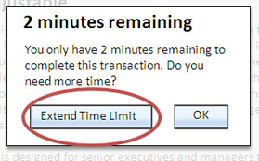
2.2 ENOUGH TIME (1)
2.2.1 Timing Adjustable (Level A) Understanding this Criterion
For each time limit that is set by the content, at least one of the following is true:
Turn off: The user is allowed to turn off the time limit before encountering it; or
Adjust: The user is allowed to adjust the time limit before encountering it over a wide range that is at least ten times the length of the default setting; or
Extend: The user is warned before time expires and given at least 20 seconds to extend the time limit with a simple action (for example, "press the spacebar"), and the user is allowed to extend the time limit at least ten times; or
(cont.)

Slide 39
2.2 ENOUGH TIME (2)
2.2.1 Timing Adjustable (Level A) (cont.)
Real-time Exception: The time limit is a required part of a real-time event (for example, an auction), and no alternative to the time limit is possible; or
Essential Exception: The time limit is essential and extending it would invalidate the activity; or
20 Hour Exception: The time limit is longer than 20 hours.
Note: This success criterion helps ensure that users can complete tasks without unexpected changes in content or context that are a result of a time limit. This success criterion should be considered in conjunction with Success Criterion 3.2.1, which puts limits on changes of content or context as a result of user action.

Slide 40
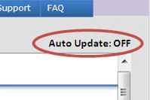
2.2 ENOUGH TIME (3)
2.2.2 Pause, Stop, Hide (Level A) Understanding this Criterion
For moving, blinking, scrolling, or auto-updating information, all of the following are true:
Moving, blinking, scrolling: For any moving, blinking or scrolling information that (1) starts automatically, (2) lasts more than five seconds, and (3) is presented in parallel with other content, there is a mechanism for the user to pause, stop, or hide it unless the movement, blinking, or scrolling is part of an activity where it is essential; and
Auto-updating: For any auto-updating information that (1) starts automatically and (2) is presented in parallel with other content, there is a mechanism for the user to pause, stop, or hide it or to control the frequency of the update unless the auto-updating is part of an activity where it is essential.
(cont.)

Slide 41
2.2 ENOUGH TIME (4)
2.2.2 Pause, Stop, Hide (cont.)
Note:
Since any content that does not meet this success criterion can interfere with a user's ability to use the whole page, all content on the Web page (whether it is used to meet other success criteria or not) must meet this success criterion.
Content that is updated periodically by software or that is streamed to the user agent is not required to preserve or present information that is generated or received between the initiation of the pause and resuming presentation, as this may not be technically possible, and in many situations could be misleading to do so.
An animation that occurs as part of a preload phase or similar situation can be considered essential if interaction cannot occur during that phase for all users and if not indicating progress could confuse users or cause them to think that content was frozen or broken.

Slide 42
2.2 ENOUGH TIME (5)
2.2.3 No Timing (Level AAA) Understanding this Criterion
Timing is not an essential part of the event or activity presented by the content, except for non-interactive synchronized media and real-time events.
2.2.4 Interruptions (Level AAA) Understanding this Criterion
Interruptions can be postponed or suppressed by the user, except interruptions involving an emergency.
2.2.5 Re-authenticating (Level AAA) Understanding this Criterion
When an authenticated session expires, the user can continue the activity without loss of data after re-authenticating.

Slide 43
2.2 ENOUGH TIME (6)
2.2.6 Timeouts (Level AAA) Understanding this Criterion
Users are warned of the duration of any user inactivity that could cause data loss, unless the data is preserved for more than 20 hours when the user does not take any actions.
Note: Privacy regulations may require explicit user consent before user identification has been authenticated and before user data is preserved. In cases where the user is a minor, explicit consent may not be solicited in most jurisdictions, countries or regions. Consultation with privacy professionals and legal counsel is advised when considering data preservation as an approach to satisfy this success criterion.

Slide 44

2.3 SEIZURES AND REACTIONS (1)
2.3.1 Three Flashes or Below Threshold Understanding this Criterion (Level A)
Web pages do not contain anything that flashes more than three times in any one second period, or the flash is below the general flash and red flash thresholds.
Note: Since any content that does not meet this success criterion can interfere with a user's ability to use the whole page, all content on the Web page (whether it is used to meet other success criteria or not) must meet this success criterion. See Conformance Requirement 5: Non-Interference.

Slide 45
2.3 SEIZURES AND REACTIONS (2)
2.3.2 Three Flashes (Level AAA) Understanding this Criterion
Web pages do not contain anything that flashes more than three times in any one second period.
2.3.3 Animation from Interactions (Level AAA) Understanding this Criterion
Motion animation triggered by interaction can be disabled, unless the animation is essential to the functionality or the information being conveyed.

Slide 46
2.4 NAVIGABLE (1)
2.4.1 Bypass Blocks (Level A) Understanding this Criterion
A mechanism is available to bypass blocks of content that are repeated on multiple Web pages.
2.4.2 Page Titled (Level A) Understanding this Criterion
Web pages have titles that describe topic or purpose.

Slide 47
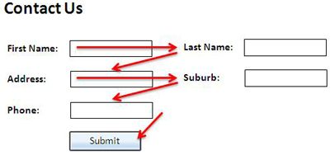
2.4 NAVIGABLE (2)
2.4.3 Focus Order (Level A) Understanding this Criterion
If a Web page can be navigated sequentially and the navigation sequences affect meaning or operation, focusable components receive focus in an order that preserves meaning and operability.
2.4.4 Link Purpose (In Context) (Level A) Understanding this Criterion
The purpose of each link can be determined from the link text alone or from the link text together with its programmatically determined link context, except where the purpose of the link would be ambiguous to users in general.

Slide 48
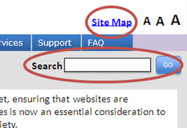
2.4 NAVIGABLE (3)
2.4.5 Multiple Ways (Level AA) Understanding this Criterion
More than one way is available to locate a Web page within a set of Web pages except where the Web Page is the result of, or a step in, a process.
2.4.6 Headings and Labels (Level AA) Understanding this Criterion
Headings and labels describe topic or purpose.

Slide 49
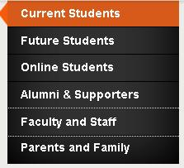
2.4 NAVIGABLE (4)
2.4.7 Focus Visible (Level AA) Understanding this Criterion
Any keyboard operable user interface has a mode of operation where the keyboard focus indicator is visible.
2.4.8 Location (Level AAA) Understanding this Criterion
Information about the user's location within a set of Web pages is available.

Slide 50
2.4 NAVIGABLE (5)
2.4.9 Link Purpose (Link Only) (Level AAA) Understanding this Criterion
A mechanism is available to allow the purpose of each link to be identified from link text alone, except where the purpose of the link would be ambiguous to users in general.
2.4.10 Section Headings (Level AAA) Understanding this Criterion
Section headings are used to organize the content.
Note: "Heading" is used in its general sense and includes titles and other ways to add a heading to different types of content.

Slide 51
2.5 INPUT MODALITIES (1)
2.5.1 Pointer Gestures (Level A) Understanding this Criterion
All functionality that uses multipoint or path-based gestures for operation can be operated with a single pointer without a path-based gesture, unless a multipoint or path-based gesture is essential.
Note: This requirement applies to web content that interprets pointer actions (i.e. this does not apply to actions that are required to operate the user agent or assistive technology).

Slide 52
2.5 INPUT MODALITIES (2)
2.5.2 Pointer Cancellation (Level A) Understanding this Criterion
For functionality that can be operated using a single pointer, at least one of the following is true:
No Down-Event: The down-event of the pointer is not used to execute any part of the function;
Abort or Undo: Completion of the function is on the up-event, and a mechanism is available to abort the function before completion or to undo the function after completion;
Up Reversal: The up-event reverses any outcome of the preceding down-event;
Essential: Completing the function on the down-event is essential.
(cont.)

Slide 53
2.5 INPUT MODALITIES (3)
2.5.2 Pointer Cancellation (Level A) (cont.)
Note:
Functions that emulate a keyboard or numeric keypad key press are considered essential.
This requirement applies to web content that interprets pointer actions (i.e. this does not apply to actions that are required to operate the user agent or assistive technology).

Slide 54
2.5 INPUT MODALITIES (4)
2.5.3 Label in Name (Level A) Understanding this Criterion
For user interface components with labels that include text or images of text, the name contains the text that is presented visually.
Note: A best practice is to have the text of the label at the start of the name.
2.5.4 Motion Actuation (Level A) Understanding this Criterion
Functionality that can be operated by device motion or user motion can also be operated by user interface components and responding to the motion can be disabled to prevent accidental actuation, except when:
Supported Interface: The motion is used to operate functionality through an accessibility supported interface;
Essential: The motion is essential for the function and doing so would invalidate the activity.

Slide 55
2.5 INPUT MODALITIES (5)
2.5.5 Target Size (Level AAA) Understanding this Criterion
The size of the target for pointer inputs is at least 44 by 44 CSS pixels except when:
Equivalent: The target is available through an equivalent link or control on the same page that is at least 44 by 44 CSS pixels;
Inline: The target is in a sentence or block of text;
User Agent Control: The size of the target is determined by the user agent and is not modified by the author;
Essential: A particular presentation of the target is essential to the information being conveyed.
2.5.6 Concurrent Input Mechanisms (Level AAA) Understanding this Criterion
Web content does not restrict use of input modalities available on a platform except where the restriction is essential, required to ensure the security of the content, or required to respect user settings.

Slide 56
3 Understandable

Slide 57
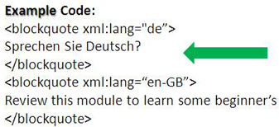
3.1 READABLE (1)
3.1.1 Language of Page (Level A) Understanding this Criterion
The default human language of each Web page can be programmatically determined.
3.1.2 Language of Parts (Level AA) Understanding this Criterion
The human language of each passage or phrase in the content can be programmatically determined except for proper names, technical terms, words of indeterminate language, and words or phrases that have become part of the vernacular of the immediately surrounding text.

Slide 58
3.1 READABLE (2)
3.1.3 Unusual Words (Level AAA) Understanding this Criterion
A mechanism is available for identifying specific definitions of words or phrases used in an unusual or restricted way, including idioms and jargon.
3.1.4 Abbreviations (Level AAA) Understanding this Criterion
A mechanism for identifying the expanded form or meaning of abbreviations is available.
3.1.5 Reading Level (Level AAA) Understanding this Criterion
When text requires reading ability more advanced than the lower secondary education level after removal of proper names and titles, supplemental content, or a version that does not require reading ability more advanced than the lower secondary education level, is available.

Slide 59
3.1 READABLE (3)
3.1.6 Pronunciation (Level AAA) Understanding this Criterion
A mechanism is available for identifying specific pronunciation of words where meaning of the words, in context, is ambiguous without knowing the pronunciation.

Slide 60
3.2 PREDICTABLE (1)
3.2.1 On Focus (Level A) Understanding this Criterion
When any user interface component receives focus, it does not initiate a change of context.
3.2.2 On Input (Level A) Understanding this Criterion
Changing the setting of any user interface component does not automatically cause a change of context unless the user has been advised of the behavior before using the component.

Slide 61
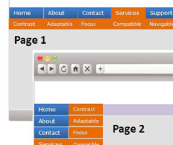
3.2 PREDICTABLE (2)
3.2.3 Consistent Navigation (Level AA) Understanding this Criterion
Navigational mechanisms that are repeated on multiple Web pages within a set of Web pages occur in the same relative order each time they are repeated, unless a change is initiated by the user.

Slide 62
3.2 PREDICTABLE (3)
3.2.4 Consistent Identification (Level AA) Understanding this Criterion
Components that have the same functionality within a set of Web pages are identified consistently.
3.2.5 Change on Request (Level AAA) Understanding this Criterion
Changes of context are initiated only by user request or a mechanism is available to turn off such changes.

Slide 63
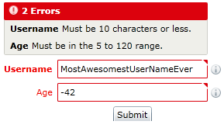
3.3 INPUT ASSISTANCE (1)
3.3.1 Error Identification (Level A) Understanding this Criterion
If an input error is automatically detected, the item that is in error is identified and the error is described to the user in text.

Slide 64
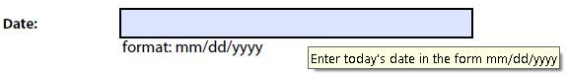
3.3 INPUT ASSISTANCE (2)
3.3.2 Labels or Instructions (Level A) Understanding this Criterion
Labels or instructions are provided when content requires user input.
3.3.3 Error Suggestion (Level AA) Understanding this Criterion
If an input error is automatically detected and suggestions for correction are known, then the suggestions are provided to the user, unless it would jeopardize the security or purpose of the content.

Slide 65
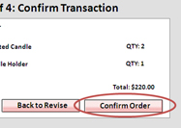
3.3 INPUT ASSISTANCE (3)
3.3.4 Error Prevention (Legal, Financial, Data) Understanding this Criterion (Level AA)
For Web pages that cause legal commitments or financial transactions for the user to occur, that modify or delete user-controllable data in data storage systems, or that submit user test responses, at least one of the following is true:
Reversible: Submissions are reversible.
Checked: Data entered by the user is checked for input errors and the user is provided an opportunity to correct them.
Confirmed: A mechanism is available for reviewing, confirming, and correcting information before finalizing the submission.

Slide 66
3.3 INPUT ASSISTANCE (4)
3.3.5 Help (Level AAA) Understanding this Criterion
Context-sensitive help is available.
3.3.6 Error Prevention (All) (Level AAA) Understanding this Criterion
For Web pages that require the user to submit information, at least one of the following is true:
Reversible: Submissions are reversible.
Checked: Data entered by the user is checked for input errors and the user is provided an opportunity to correct them.
Confirmed: A mechanism is available for reviewing, confirming, and correcting information before finalizing the submission.

Slide 67
4 Robust

Slide 68
4.1 COMPATIBLE (1)
4.1.1 Parsing (Level A) Understanding this Criterion
In content implemented using markup languages, elements have complete start and end tags, elements are nested according to their specifications, elements do not contain duplicate attributes, and any IDs are unique, except where the specifications allow these features.
Note: Start and end tags that are missing a critical character in their formation, such as a closing angle bracket or a mismatched attribute value quotation mark are not complete.

Slide 69
4.1 COMPATIBLE (2)
4.1.2 Name, Role, Value (Level A) Understanding this Criterion
For all user interface components (including but not limited to: form elements, links and components generated by scripts), the name and role can be programmatically determined; states, properties, and values that can be set by the user can be programmatically set; and notification of changes to these items is available to user agents, including assistive technologies.
Note: This success criterion is primarily for Web authors who develop or script their own user interface components. For example, standard HTML controls already meet this success criterion when used according to specification.
4.1.3 Status Messages (Level AA) Understanding this Criterion
In content implemented using markup languages, status messages can be programmatically determined through role or properties such that they can be presented to the user by assistive technologies without receiving focus.

Slide 70
SUCCESS CRITERIA SUMMARY
Perceivable
A 1.1.1, 1.2.1, 1.2.2, 1.2.3, 1.3.1, 1.3.2, 1.3.3, 1.4.1, 1.4.2
AA 1.2.4, 1.2.5, 1.3.4, 1.3.5, 1.4.3, 1.4.4, 1.4.5, 1.4.10, 1.4.11, 1.4.12, 1.4.13
AAA 1.2.6, 1.2.7, 1.2.8, 1.2.9, 1.3.6, 1.4.6, 1.4.7, 1.4.8, 1.4.9
Operable
A 2.1.1, 2.1.2, 2.1.4, 2.2.1, 2.2.2, 2.3.1, 2.4.1, 2.4.2, 2.4.3, 2.4.4, 2.5.1, 2.5.2, 2.5.3, 2.5.4
AA 2.4.5, 2.4.6, 2.4.7
AAA 2.1.3, 2.2.3, 2.2.4, 2.2.5, 2.2.6, 2.3.2, 2.3.3, 2.4.8, 2.4.9, 2.4.10, 2.5.5, 2.5.6
Understandable
A 3.1.1, 3.2.1, 3.2.2, 3.3.1, 3.3.2
AA 3.1.2, 3.2.3, 3.2.4, 3.3.3, 3.3.4
AAA 3.1.3, 3.1.4, 3.1.5, 3.1.6, 3.2.5, 3.3.5, 3.3.6
Robust
A 4.1.1, 4.1.2
AA 4.1.3

Slide 71
THE WCAG 2.0 DOCUMENTS - REVIEW
Quick Reference Link

Slide 72
Test Results - Issues

Slide 73
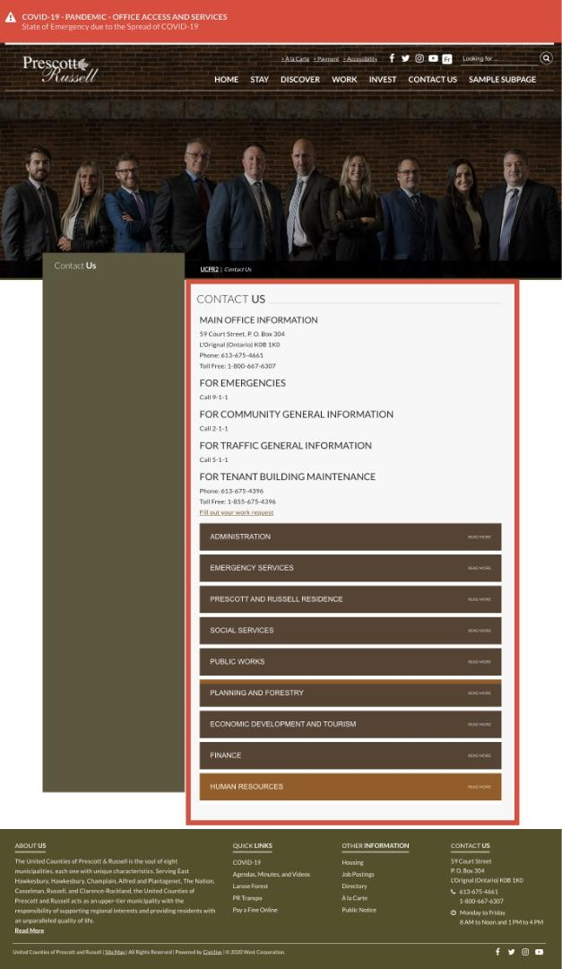
Issue: CON-01-SR
Page does not have a main landmark.
A main landmark should contain the
main content of the page.

Slide 74
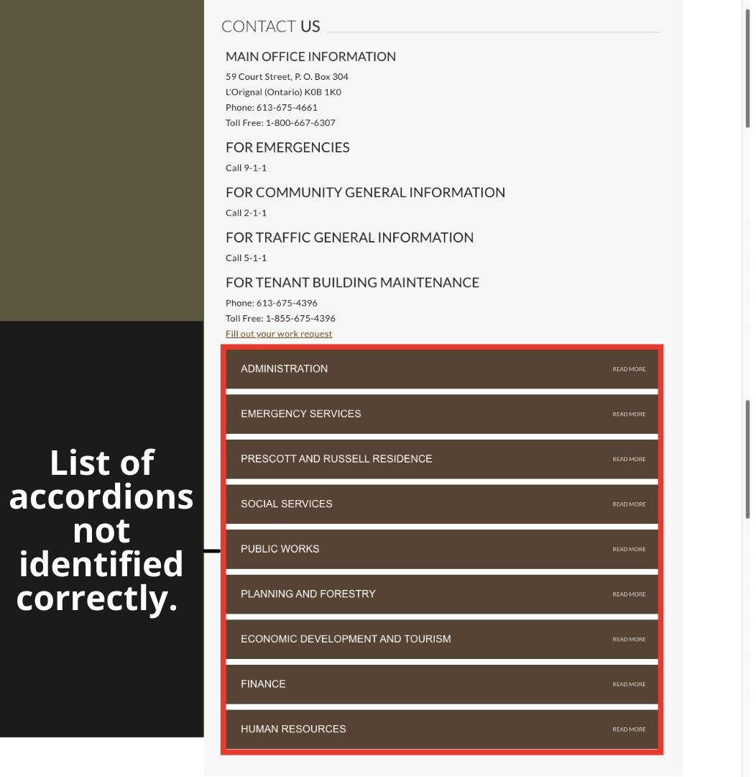
Issue: CON-02-SR
List (grouping) of the accordion headers is not identified correctly. Visually the accordion headers is presented as a grouping of alike items (in this case visually it is a group of 9 items, but
2 groups of 7 and 2 items each
programmatically).

Slide 75
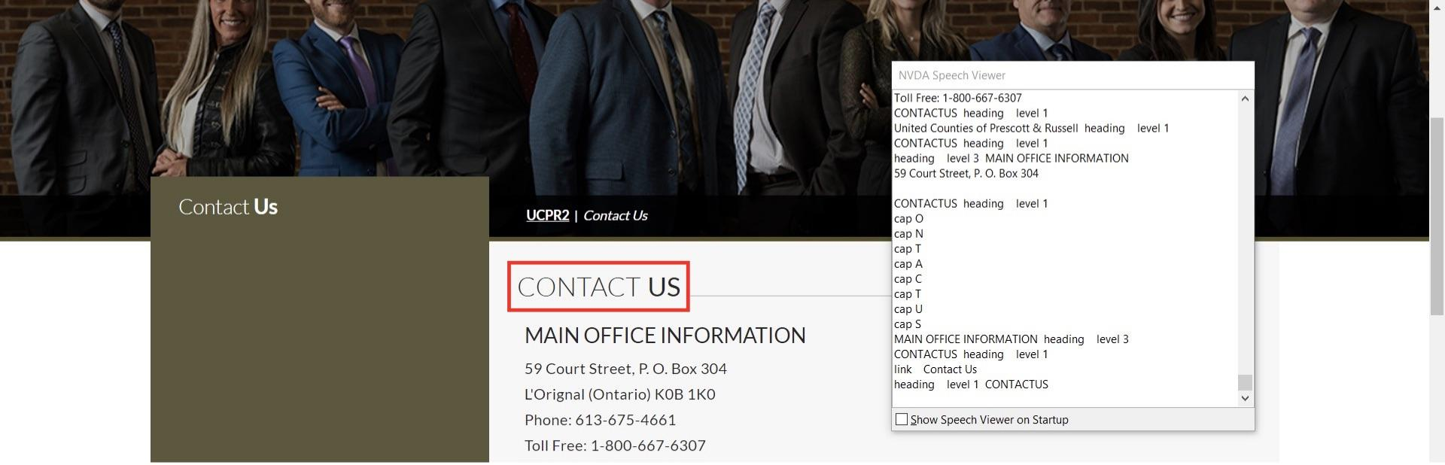
Issue: CON-03-SR
Main heading announced as a joint word to screen readers.
In the pages where the main heading contains more than one word, the screen reader announcement happens as a joint word.

Slide 76
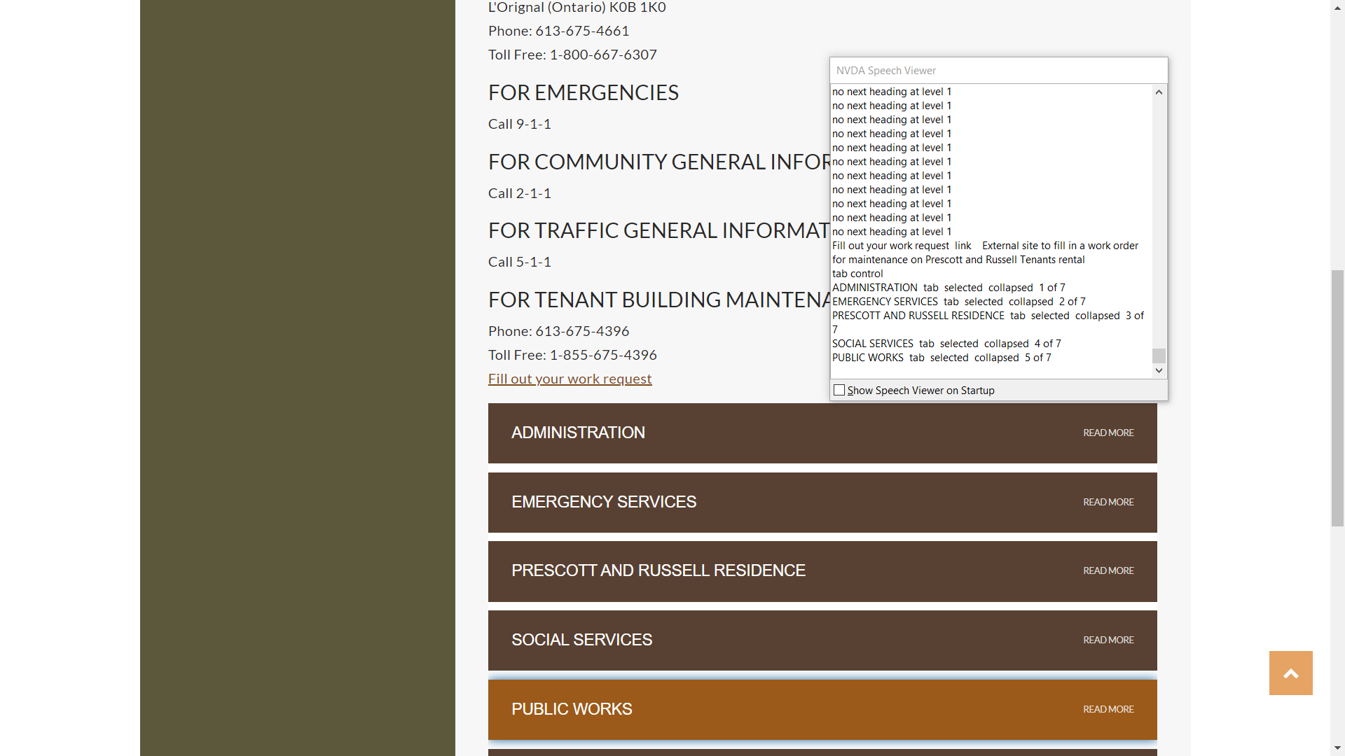
Issue: CON-04-SR
Correct role of the accordion headers is not communicated to the assistive technology. Accordion headers are exposed as tabs in the code, accordions and tabs have different keyboard behaviour causing an issue for all the assistive technology users.

Slide 77
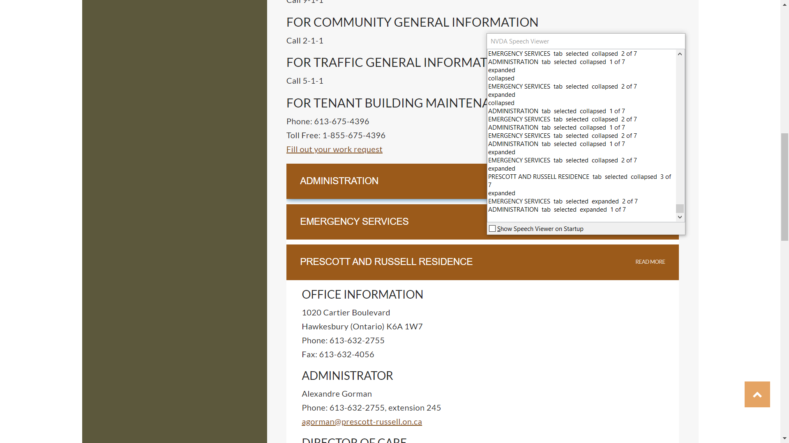
Issue: CON-05-SR
Programmatic state of the accordion headers do not change. When a user expands an accordion with one already expanded, the first one collapses visually but the programmatic state remains expanded thus communicating incorrect info to the screen readers.

Slide 78
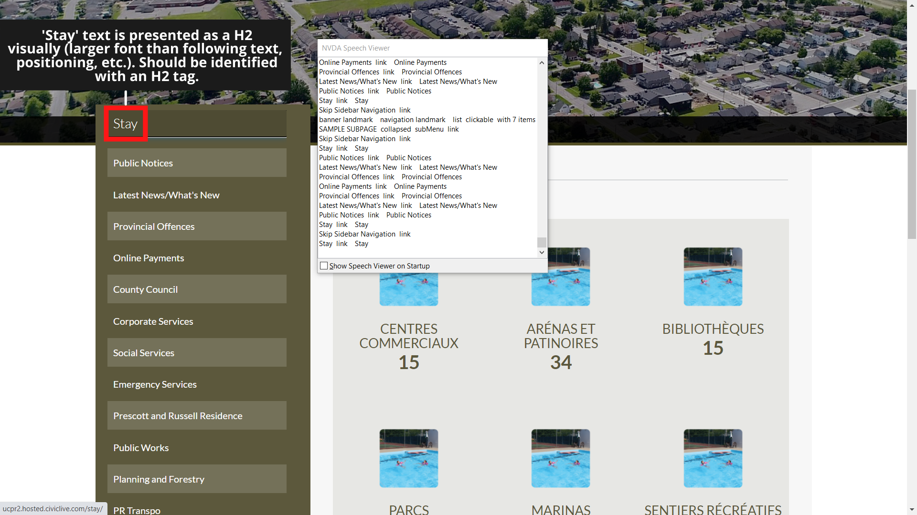
Issue: SNN-01-SR
Text qualifying to be a heading not identified as a heading. The visually larger text in the Side Navigation which represents a logical relationship with the items below (‘Stay’ link in this case) qualifies to be identified as a heading, so that the same relationship can be established programmatically.

Slide 79
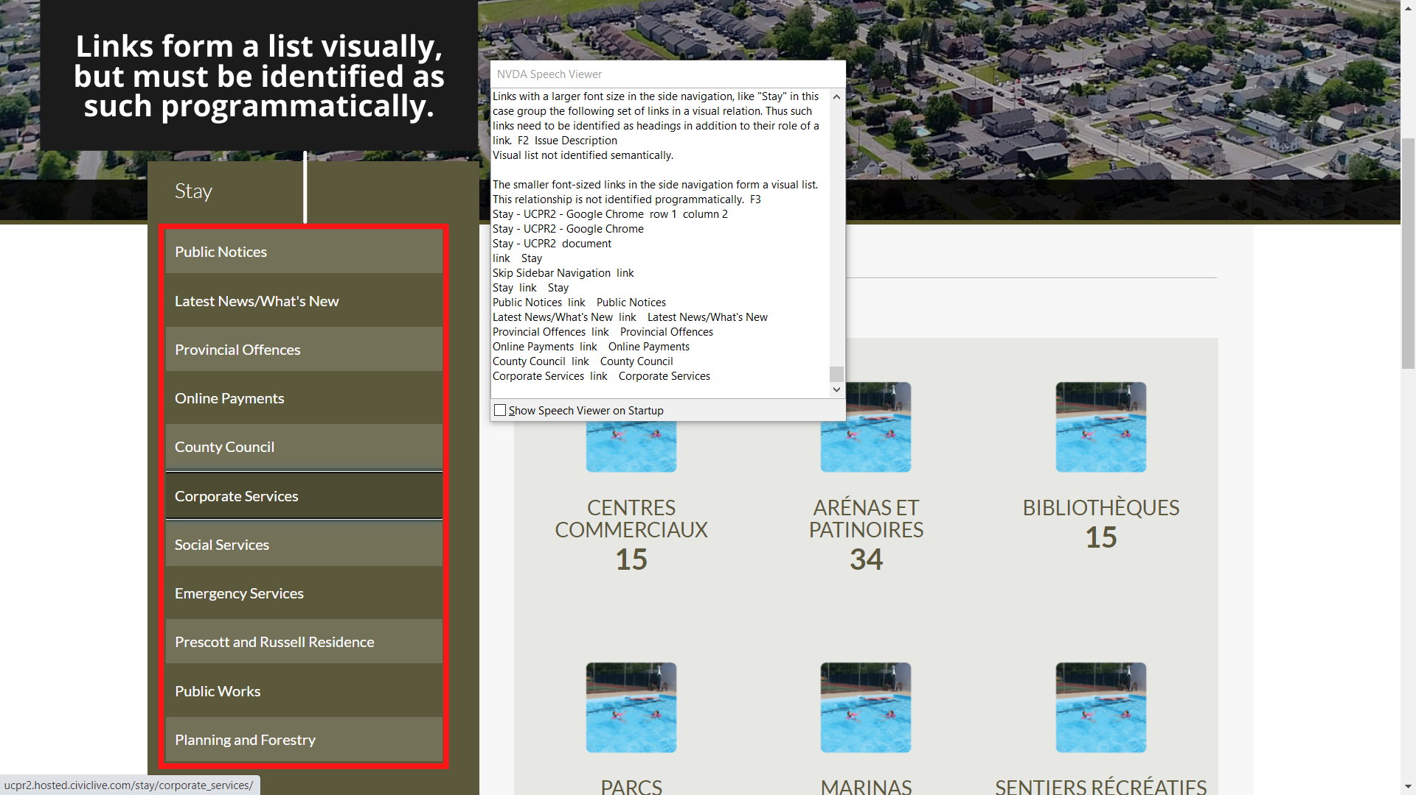
Issue: SNN-02-SR
Visual list is not identified semantically.
The small sized items in the side navigation form a logical list, this relationship is not identified programmatically.

Slide 80
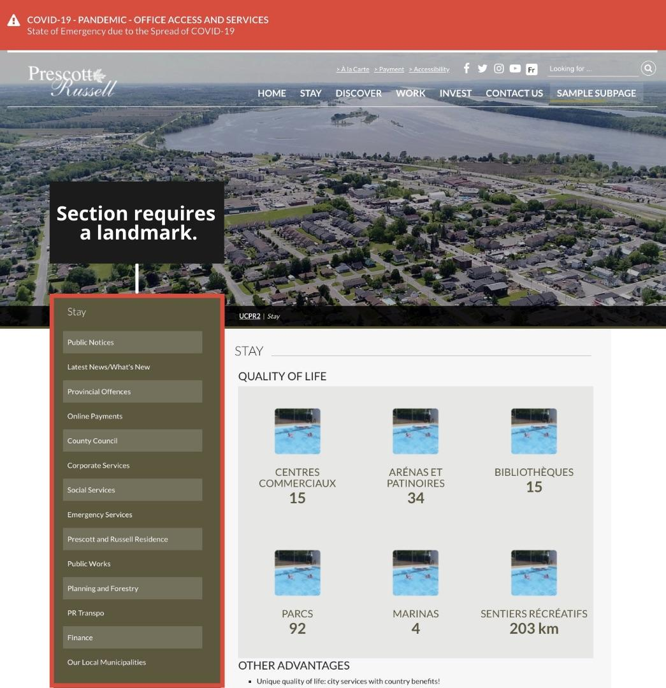
Issue: CON-03-SR
The Side Navigation region is not contained by a landmark currently. It should be in a navigation landmark.

Slide 81
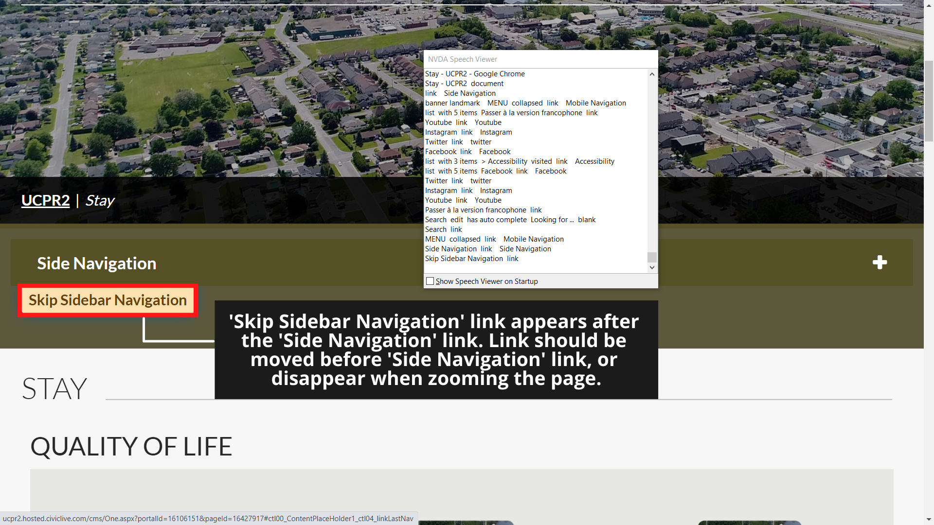
Issue: SNN-04-KN
Skip link is not present at a meaningful position. Upon zoom the skip link appears after the side navigation link.

Slide 82
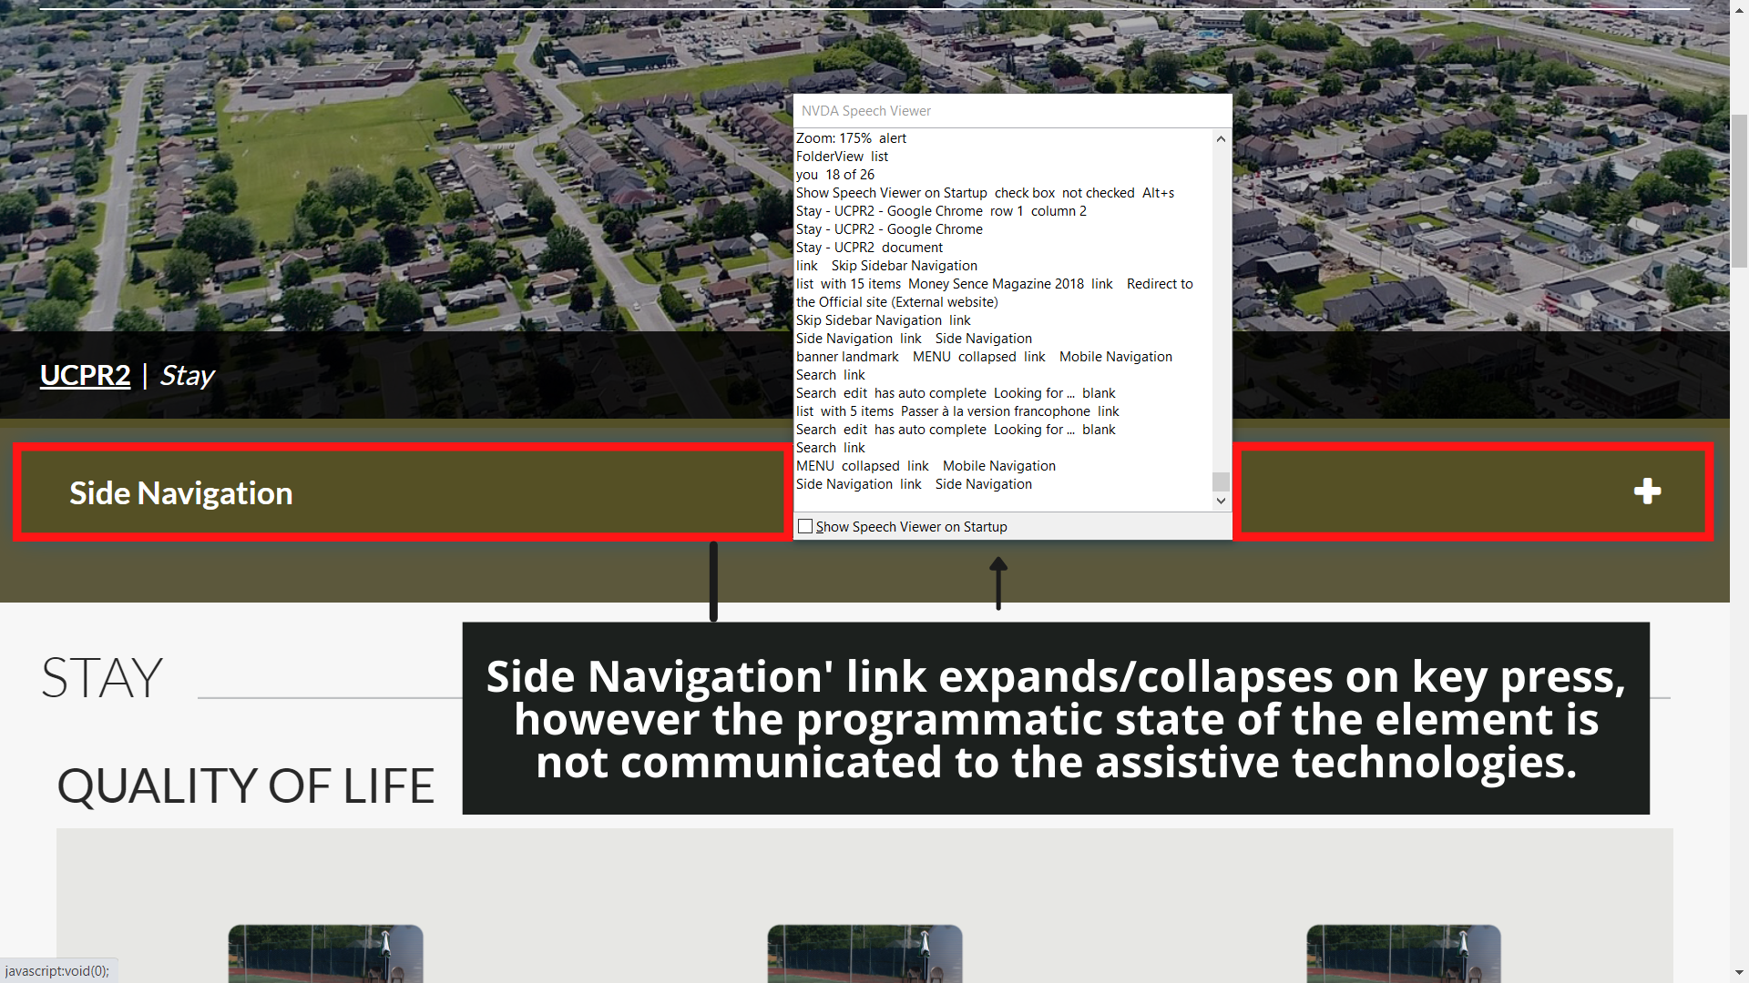
Issue: SNN-05-SR
Programmatic state of the side navigation link (which appears on zoom) is not communicated to the assistive technologies.
Visually the expandable/collapsible functionality is present using ‘+’/’-’ symbols but the same information is not available programmatically.

Slide 83
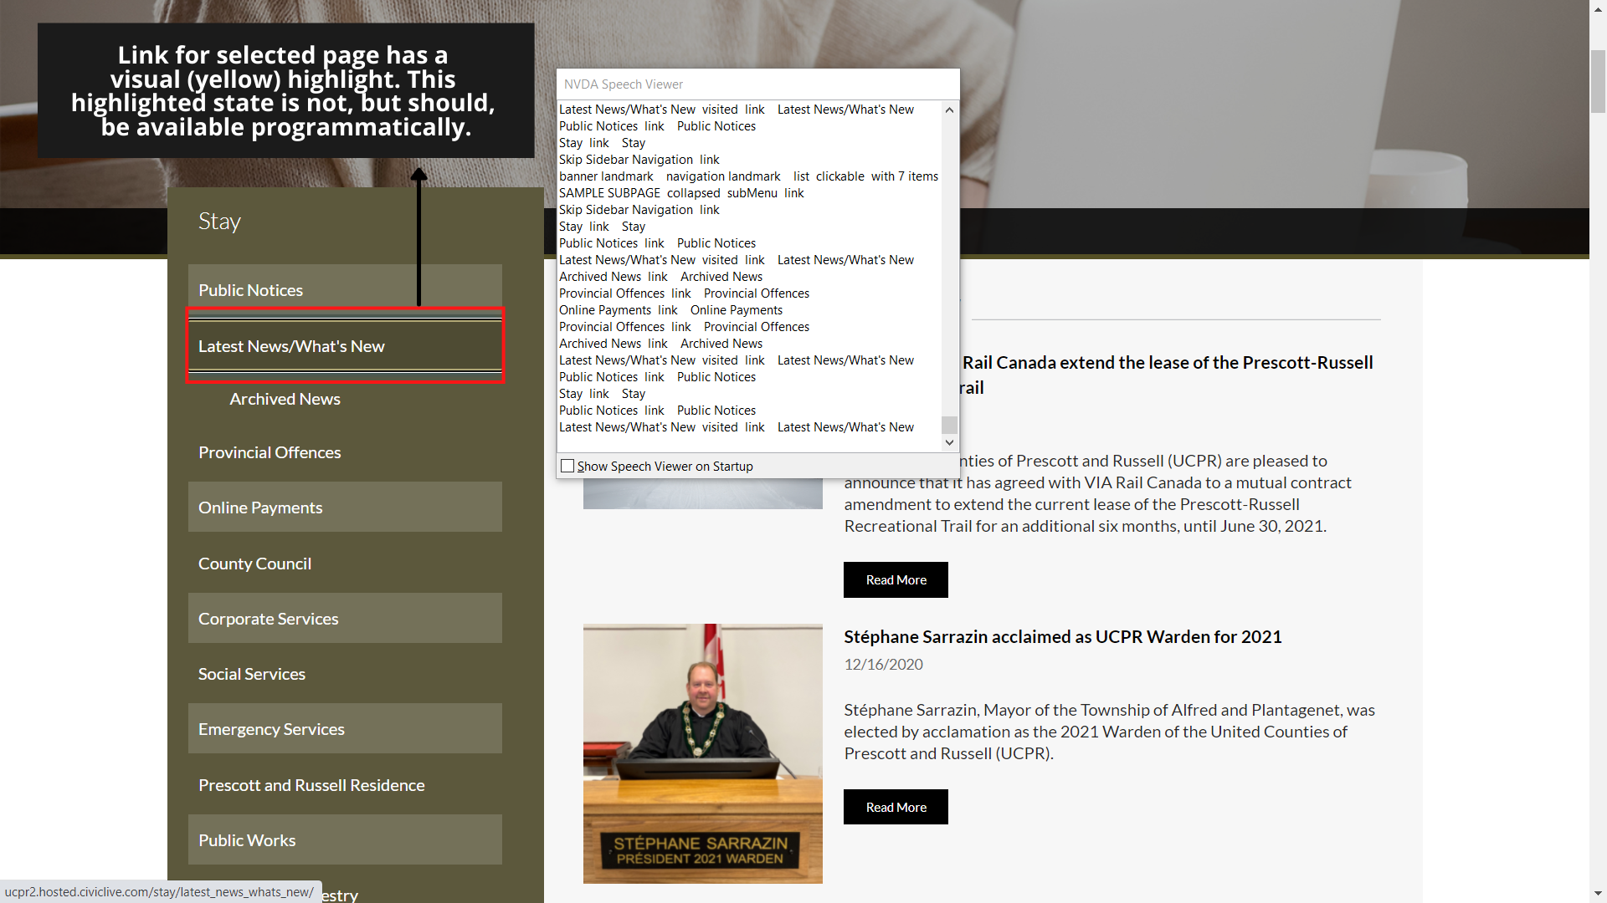
Issue: SNN-06-SR
Programmatic state of the currently selected link is not available.
The currently selected link is evident visually because of the yellow selection lines around it, but this information is not available programmatically.

Slide 84
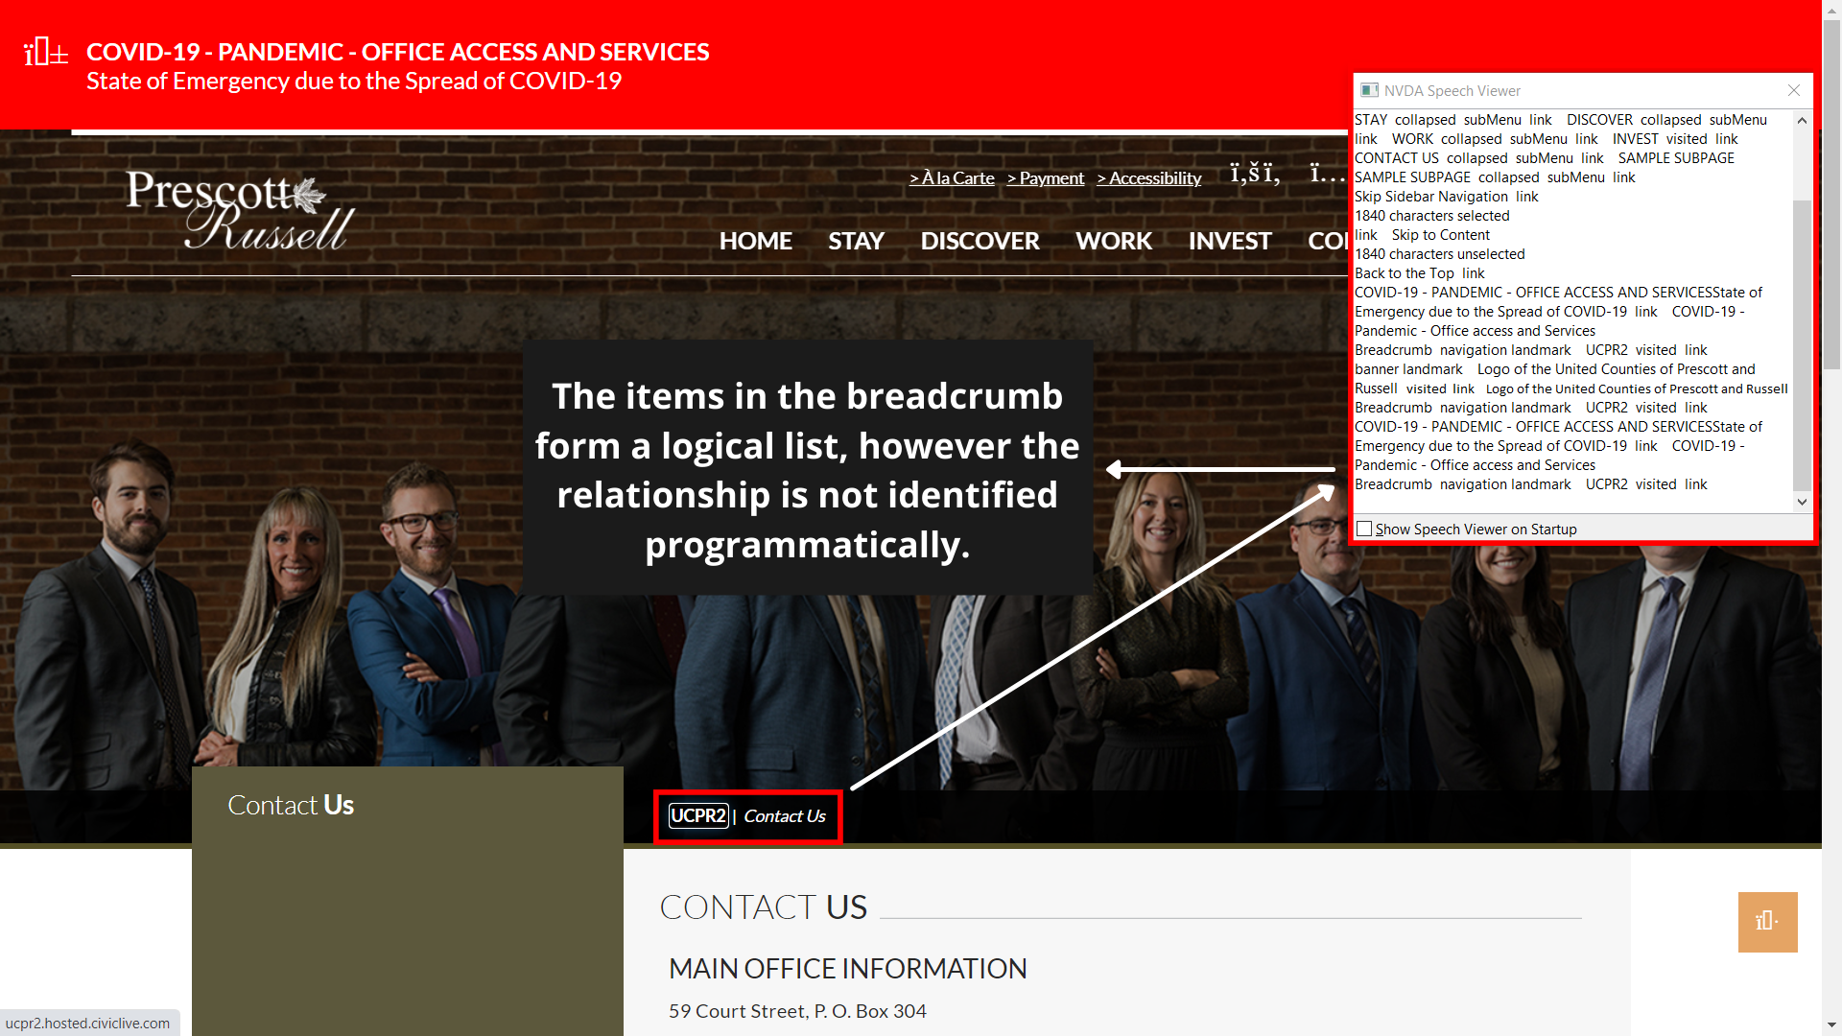
Issue: HER-01-SR
Elements in the breadcrumb should be exposed as a list.
Currently they do not have the semantic relationship.

Slide 85
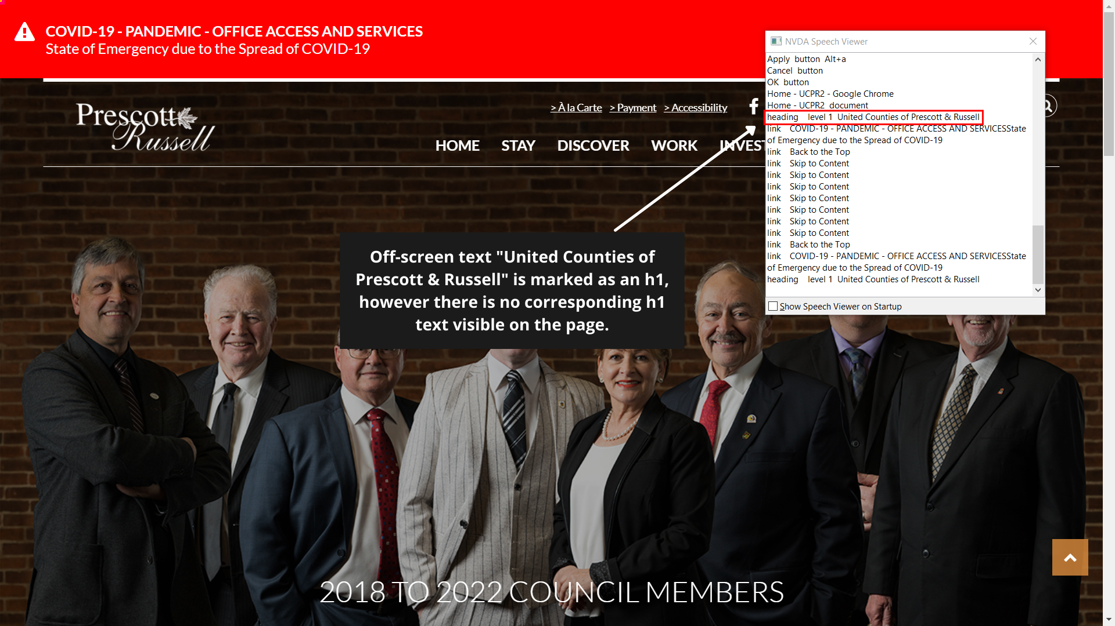
Issue: HER-02-SR
“United Counties of Prescott and Russell” is a hidden heading in the header.
It does not seem to serve any purpose or describe a section.

Slide 86
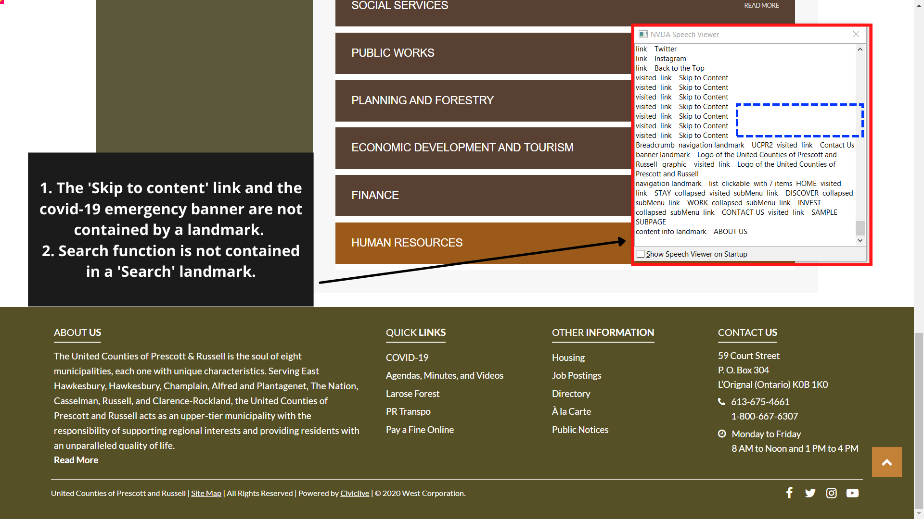
Issue: HER-03-SR
Landmarks are not properly defined on the page.
Skip link and covid alert are not in any landmark.

Slide 87
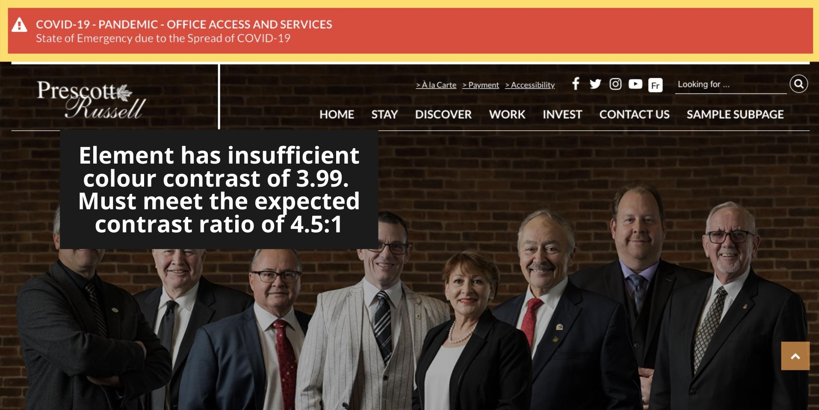
Issue: HER-04-CC
Part of the Covid-19 alert has insufficient colour contrast.
CC value: 3.99:1 (White on red).

Slide 88
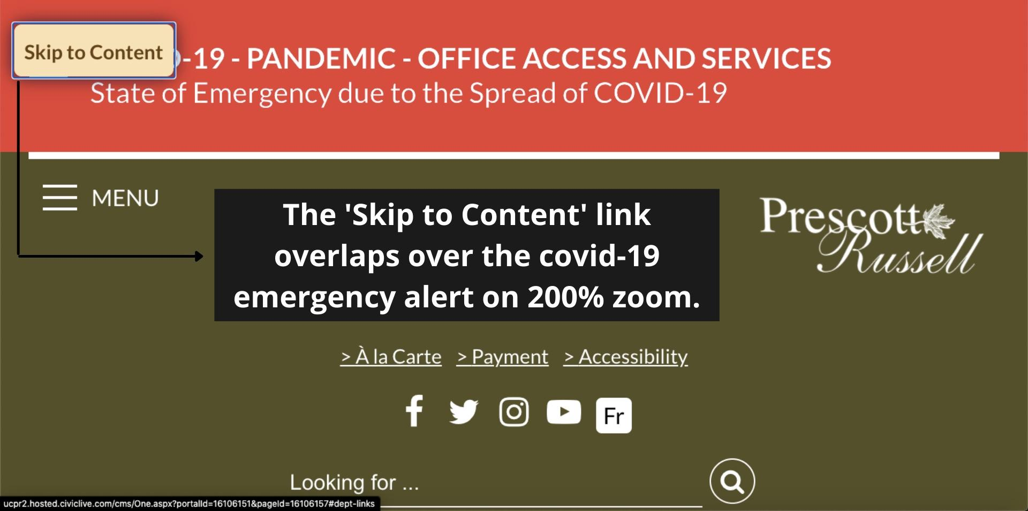
Issue: HER-05-ZM, HER-06-ZM
When the skip link appears it overlaps with the Covid-19 alert.

Slide 89
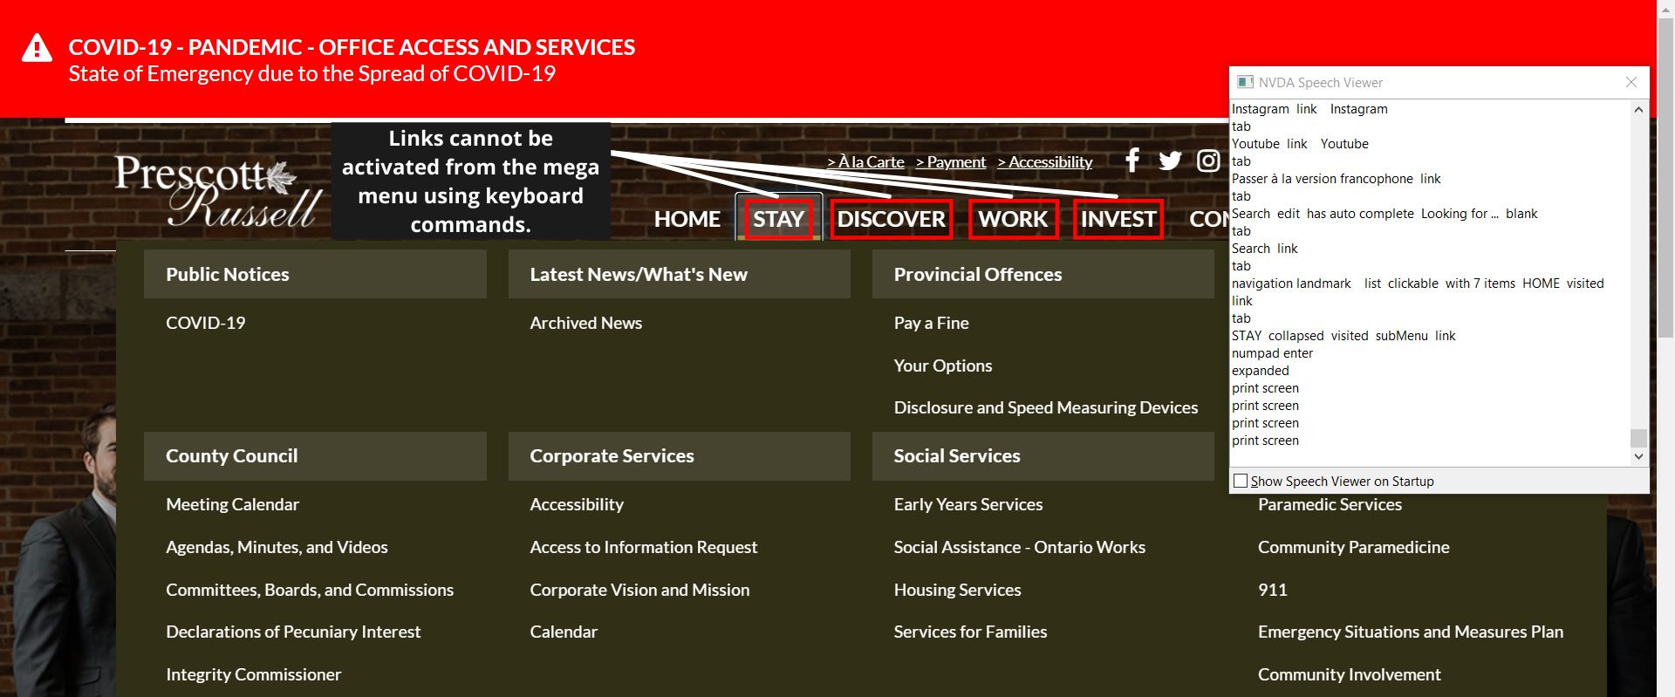
Issue: HER-07-KN
Links ‘Stay’, ‘Discover’, ‘Invest’ and ‘Work’ from main menu cannot be activated using keyboard.
Activating them opens up the flyout menu.
There is no mechanism to reach the links using keyboard from the main menu.

Slide 90
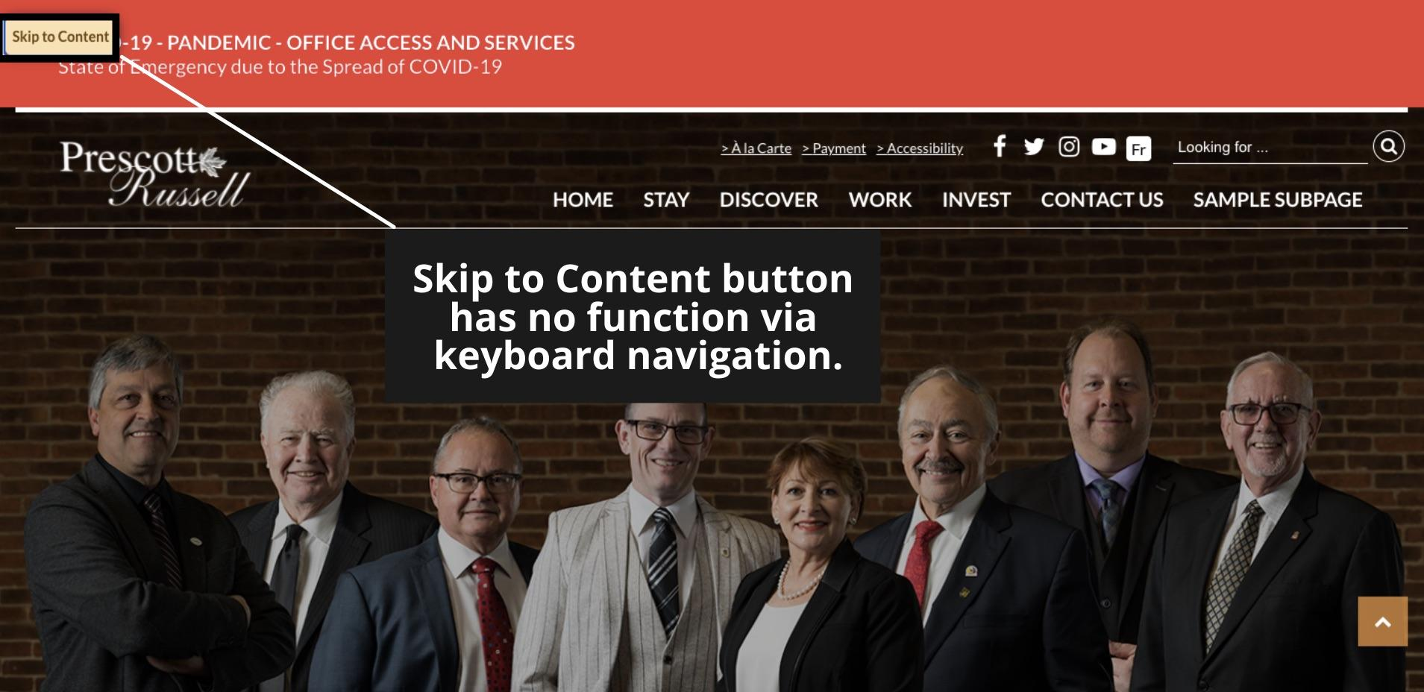
Issue: HER-08-KN
Skip link is not functional.
Activating the skip link does not move the focus to the main content, instead the focus remains on the link.
In some pages it refreshes the page.

Slide 91
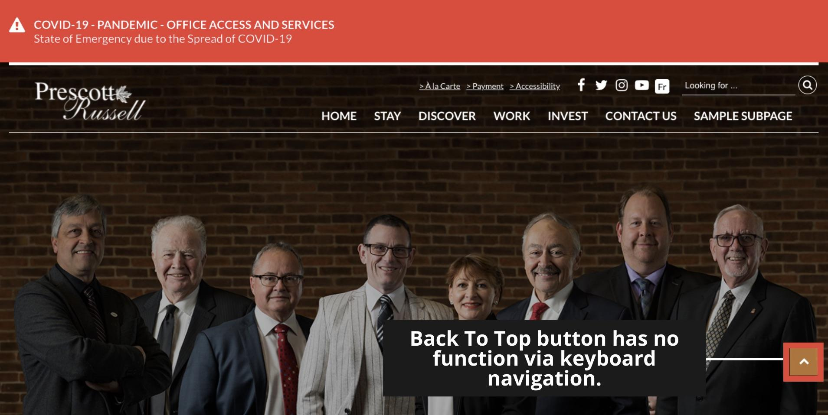
Issue: HER-09-KN
The ‘Back to the Top’ link is not working properly.
Activating the link scrolls the page but the programmatic focus remains on the link.

Slide 92
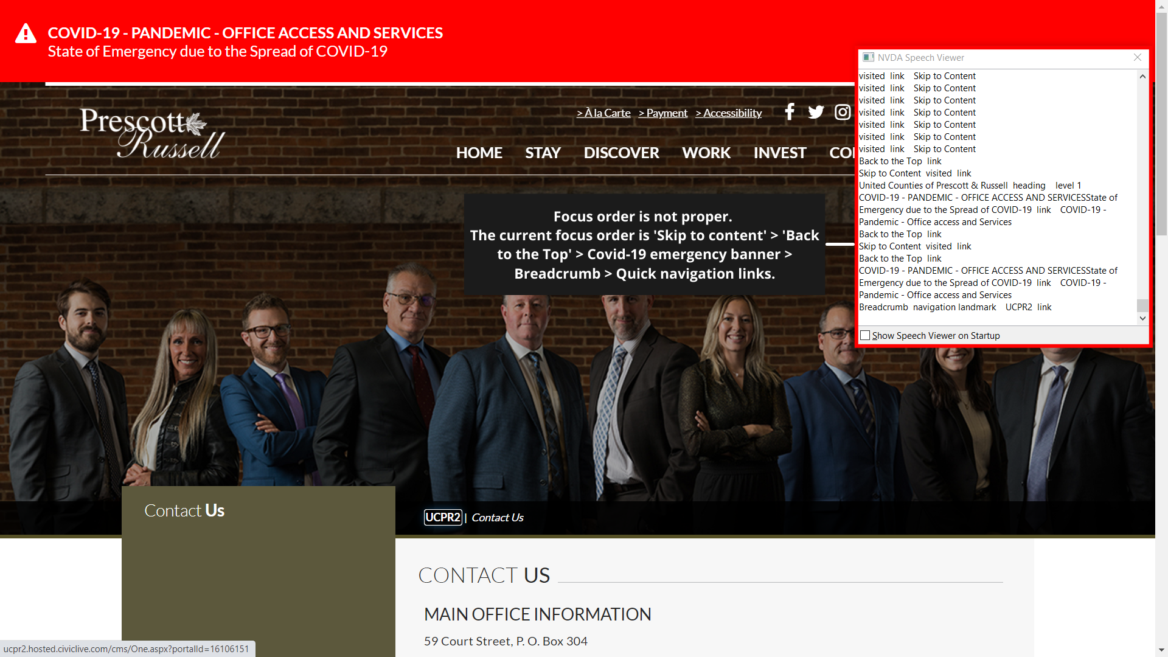
Issue: HER-10-KN
Focus order is not proper.
Current focus order: Skip link > Back to the top link > covid-19 alert > breadcrumbs > quick navigation links.

Slide 93
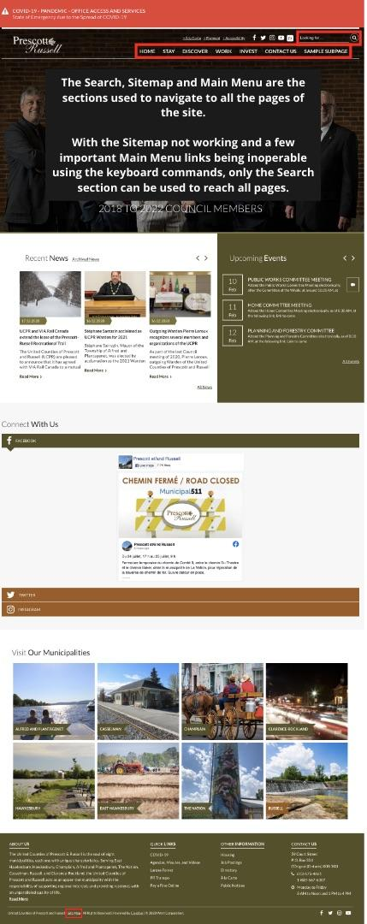
Issue: HER-11-OA
Less than two ways present to reach all the pages of the website.
Common ways: Search, main navigation, Sitemap, A-Z index.
On UCPR: Search works, main navigation has glitches, Sitemap is not working.
Should be resolved
with HER-07-KN.

Slide 94
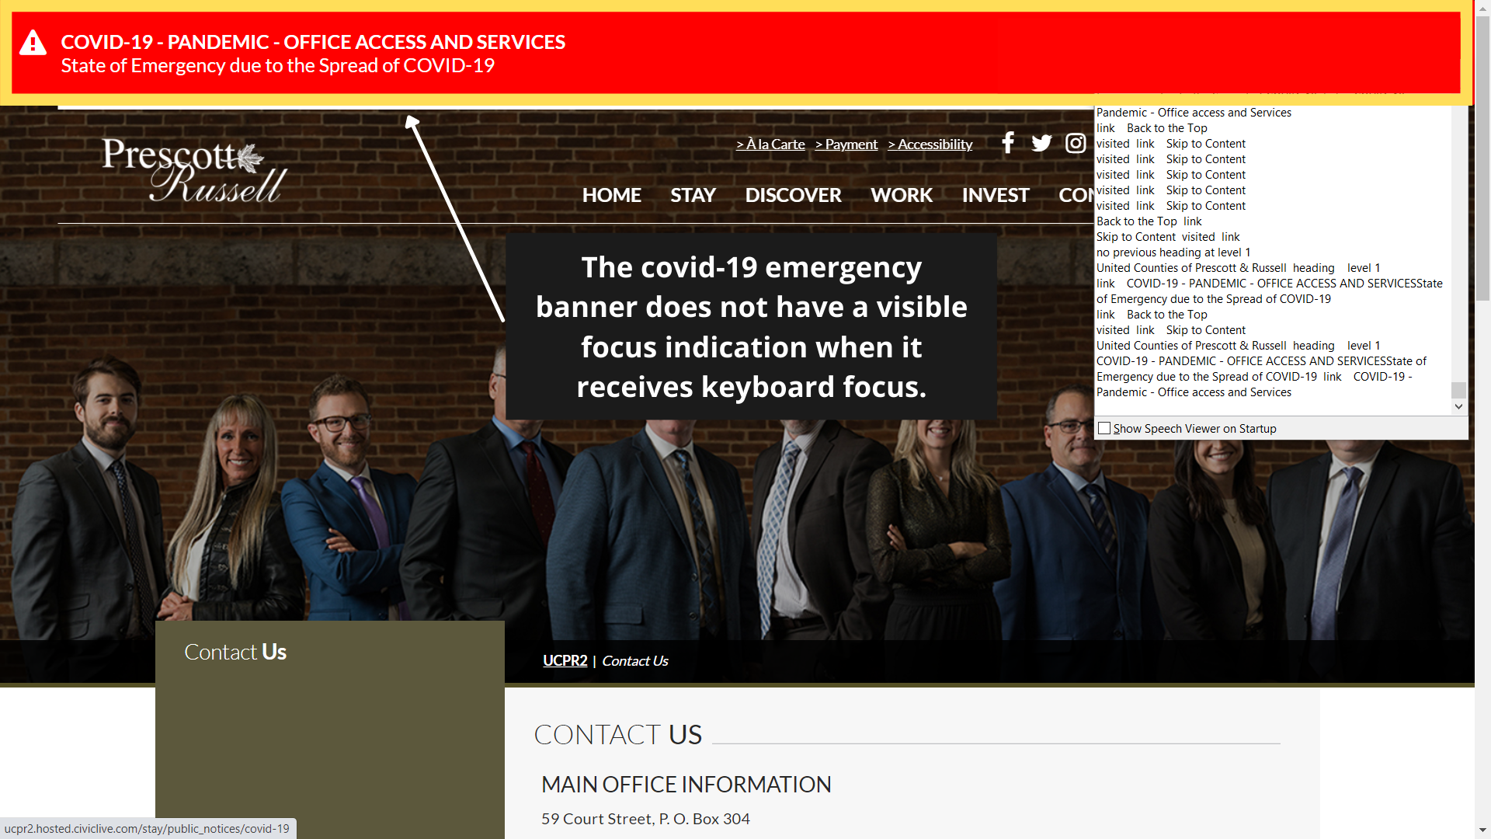
Issue: HER-12-KN
Covid-19 alert does not take a visible focus indication.

Slide 95
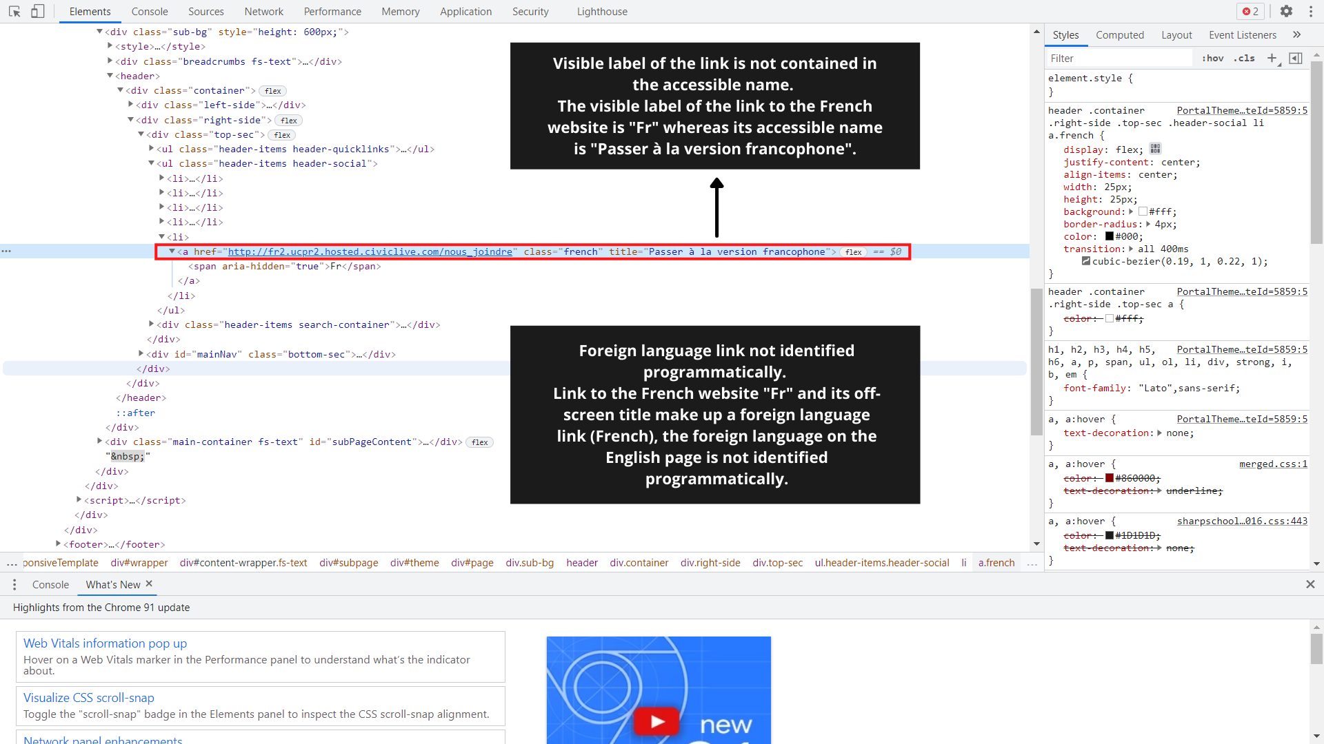
Issue: HER-13-OA, HER-14-SR
Visible label: Fr
Accessible name: Passer à la version francophone
Language of the foreign language word not identified.

Slide 96
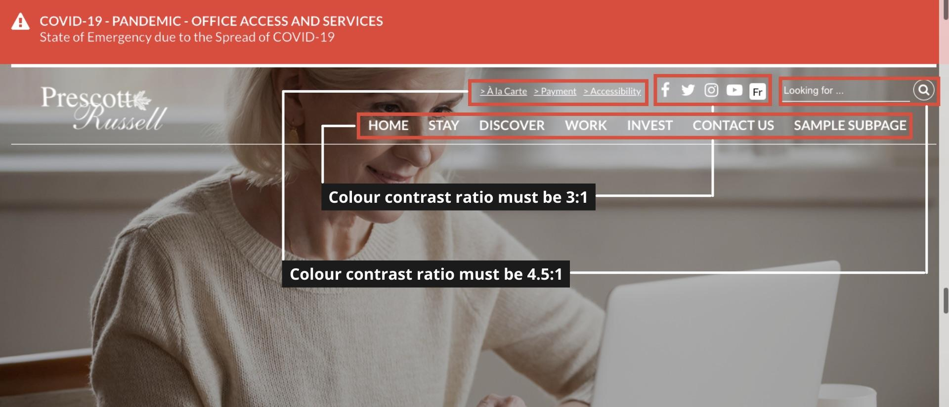
Issue: HER-X1-CC, HER-X2-CC, HER-X3-CC, HER-X4-CC
Depending on the colour of the banner image:
Main menu items have insufficient colour contrast.
Quick navigation links have insufficient colour contrast.
Search text and link have insufficient colour contrast.
Icons have insufficient colour contrast.

Slide 97
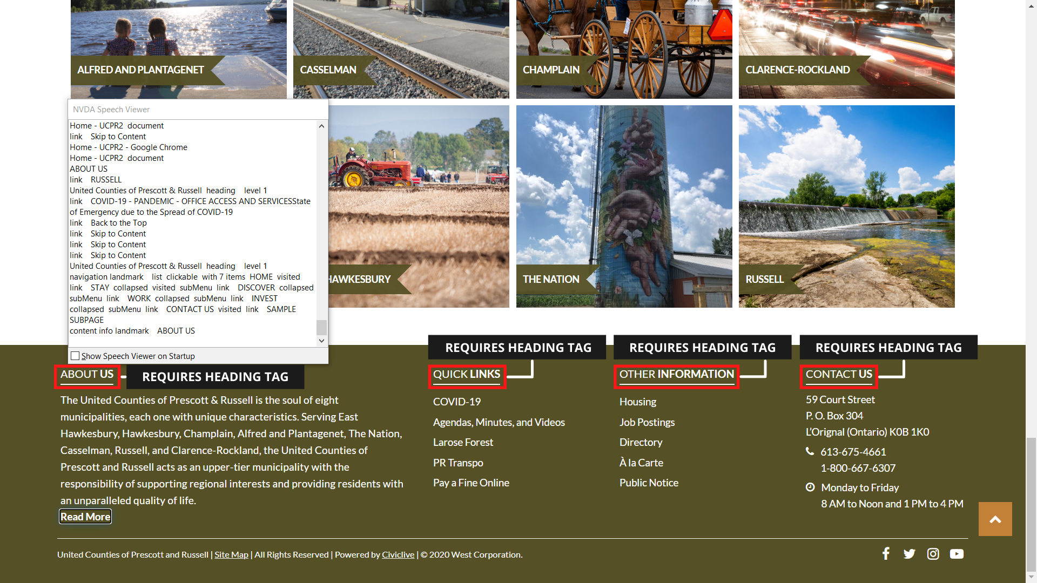
Issue: FOR-01-SR
Text which serves as a visual heading is not identified as a heading programmatically.
"ABOUT US", "QUICK LINKS", "OTHER INFORMATION", and "CONTACT US“.

Slide 98
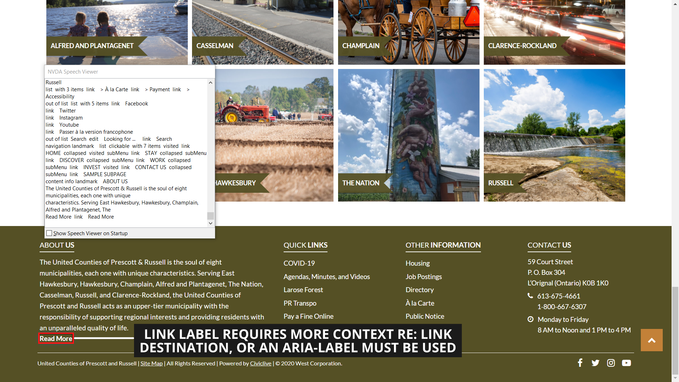
Issue: FOR-02-SR
Link text out of context.
“Read more” is not providing enough context on where it is leading to.

Slide 99
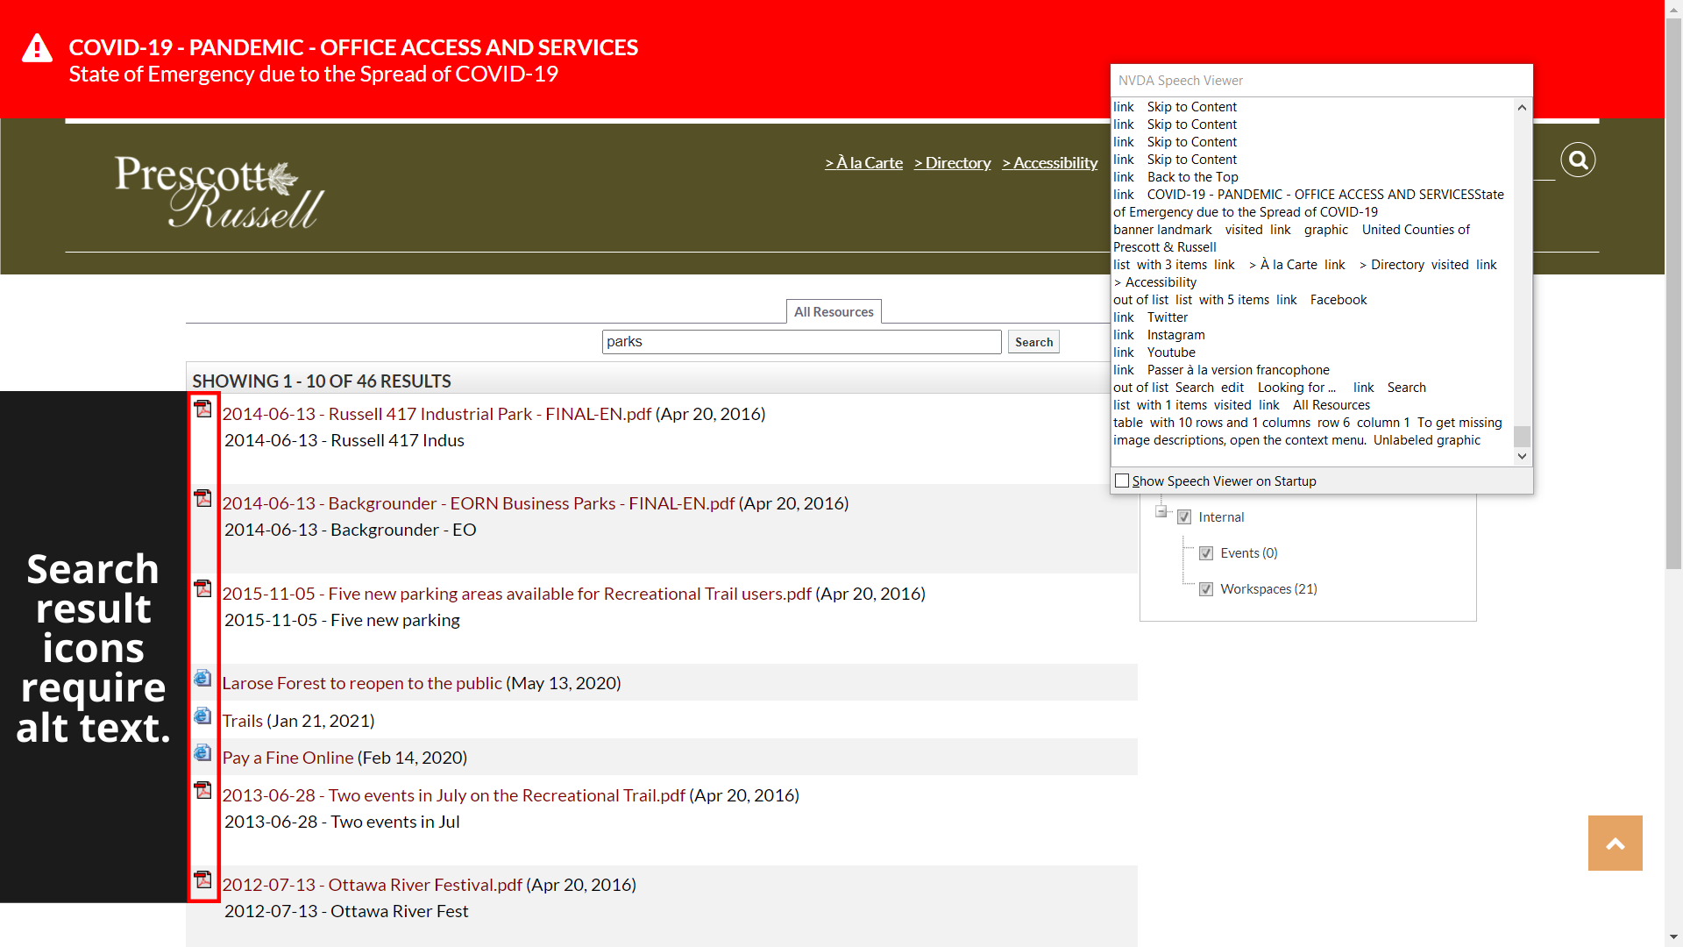
Issue: SEH-01-SR
Images missing alt text.
On the search results page there are icons against each search result conveying the type of result it is, web page, pdf, meeting, etc. These icons have no alt text associated to them.

Slide 100
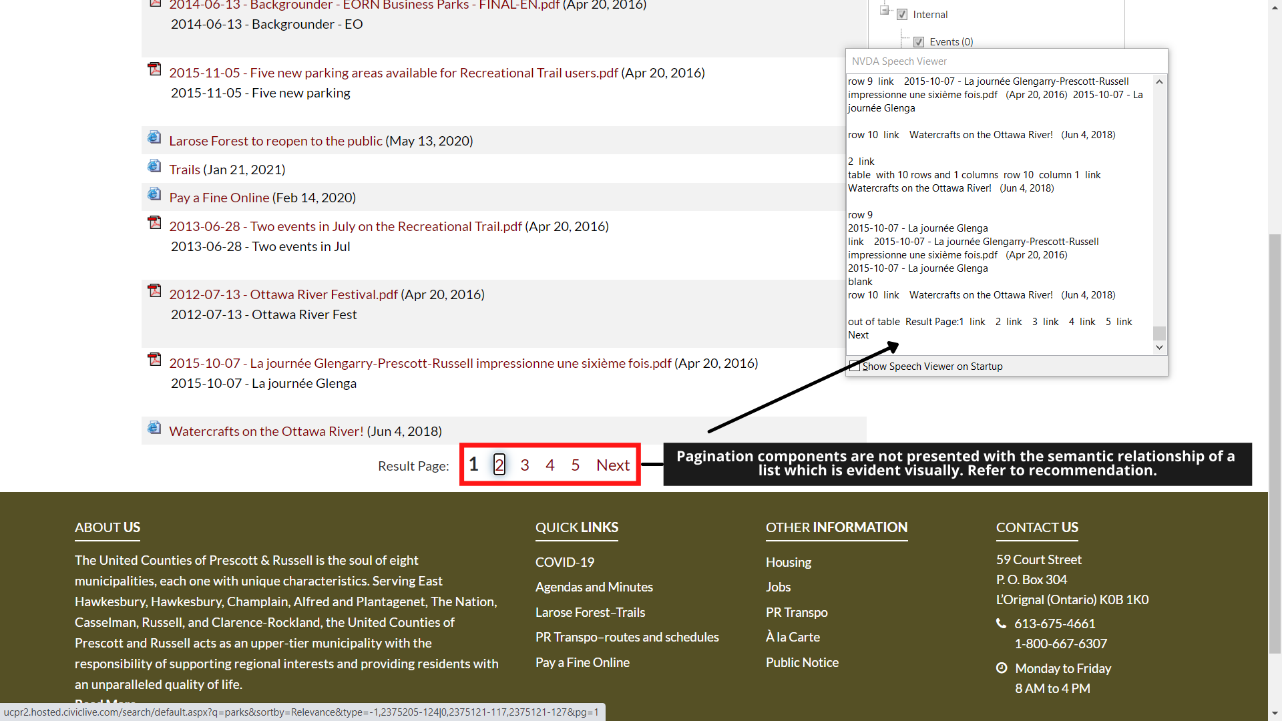
Issue: SEH-02-SR
Relationship is not presented semantically.
The pagination components do not have the programmatic relationship of a list which is evident visually.

Slide 101
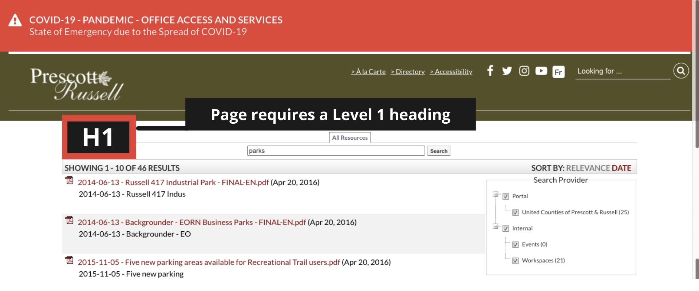
Issue: SEH-03-SR
The page has no main heading.
A page needs headings to organize the contents of the page.
Landmarks and headings, both are not proper. Having at least one of them is essential for the compliance.

Slide 102
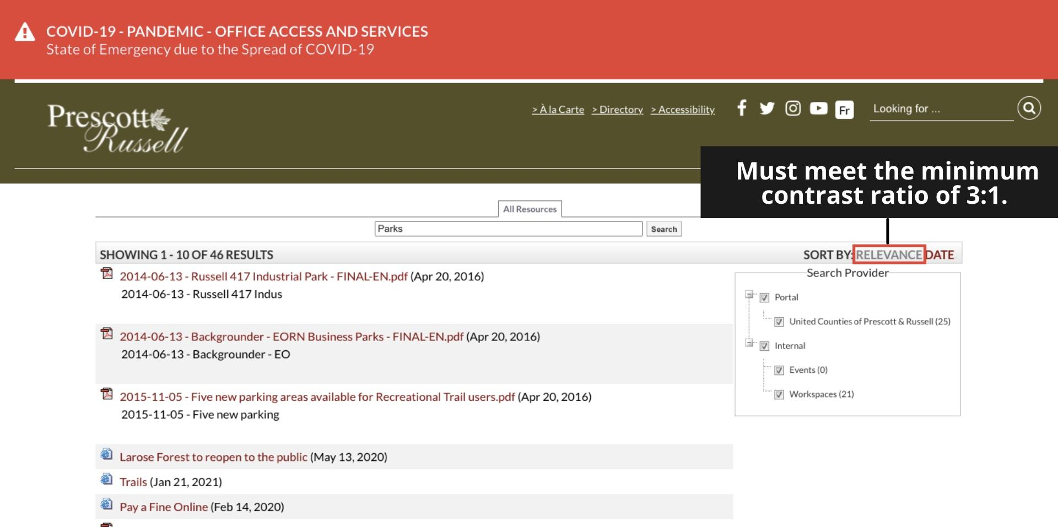
Issue: SEH-04-CC
The sort option which is not selected has insufficient colour contrast.
CC value: 2.04:1 (light grey on white background)
Expected contrast ratio: 4.5:1 (minimum)

Slide 103
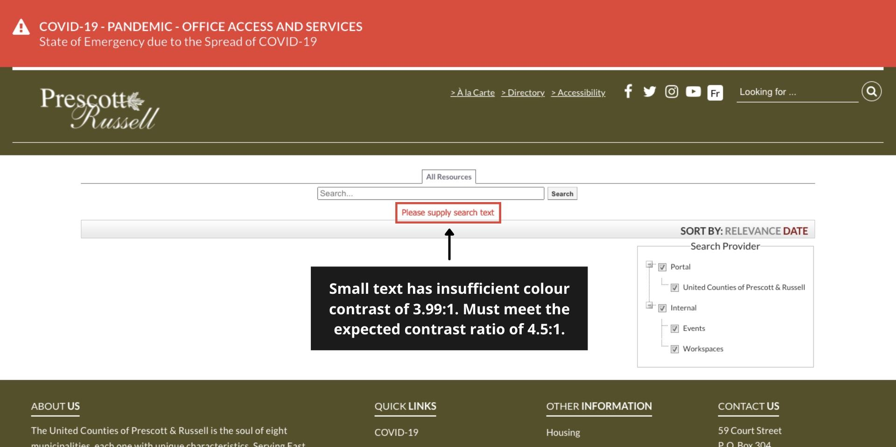
Issue: SEH-05-CC
The error which appears on hitting ‘Search’ with an empty query has insufficient colour contrast.
CC value: 3.99:1 (red on white background)
Expected contrast ratio: 4.5:1 (minimum)

Slide 104
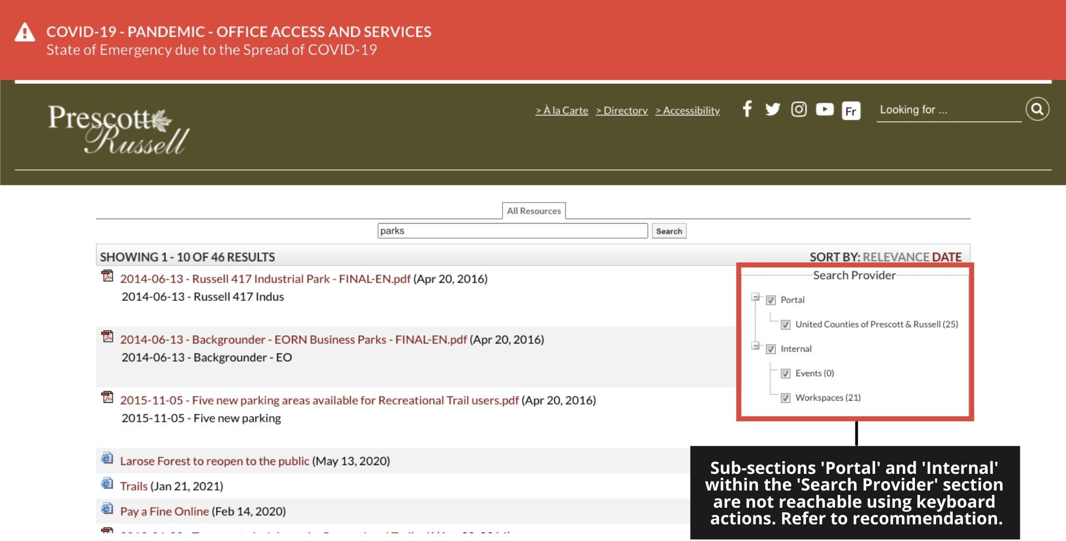
Issue: SEH-06-KN
The expandable/collapsible options within the ‘Search Provider’ are not reachable with the keyboard.

Slide 105
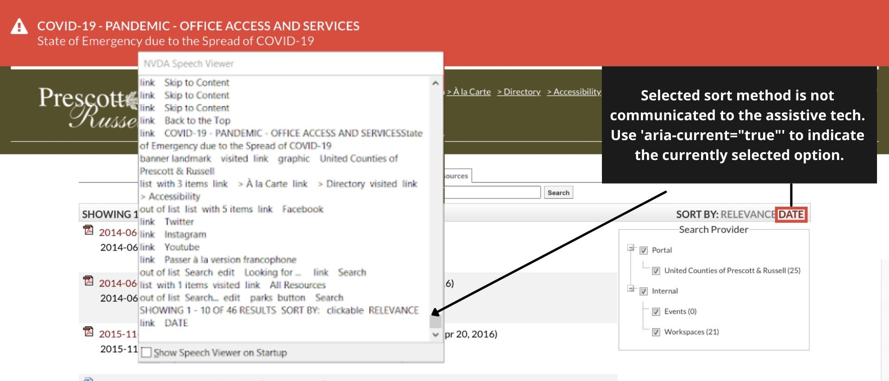
Issue: SEH-07-SR
Current selection not communicated to the screen readers.
The currently selected sort functionality is evident visually but the selection is not communicated programmatically to the screen readers.

Slide 106
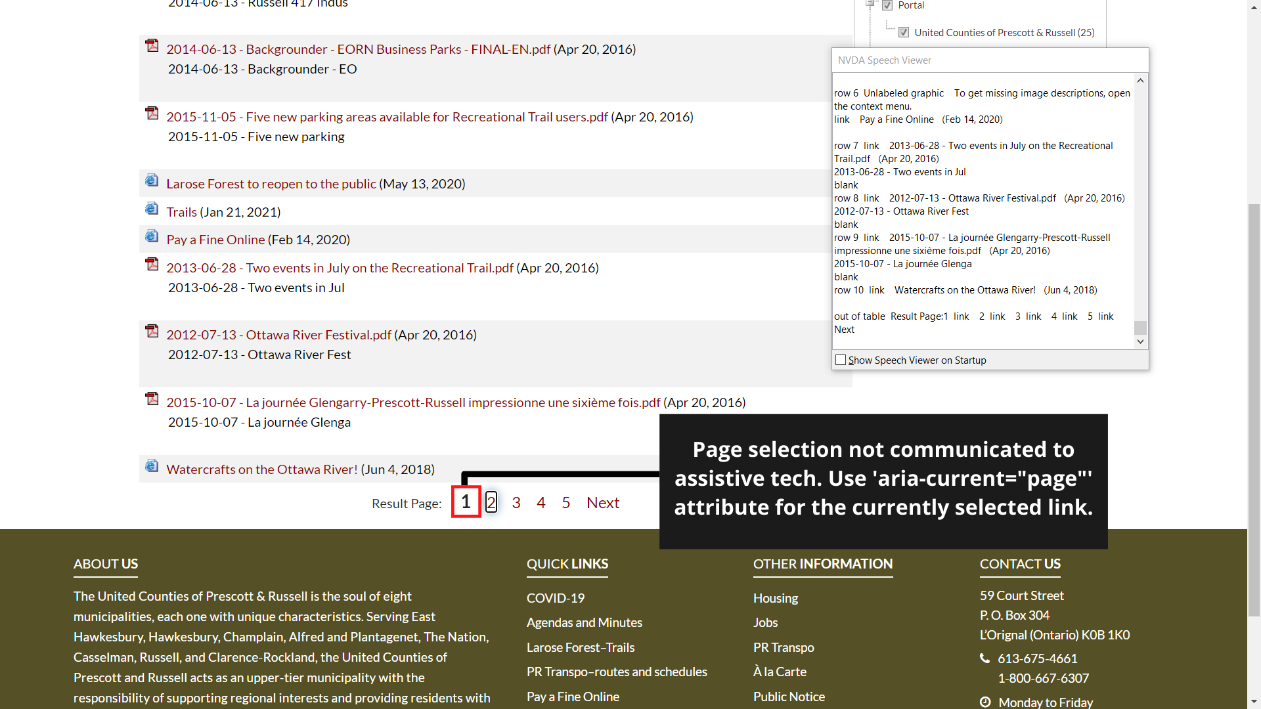
Issue: SEH-08-SR
Current selection not communicated to the screen readers.
The currently selected page in the pagination is evident visually, but the selection is not communicated programmatically to the screen readers.

Slide 107
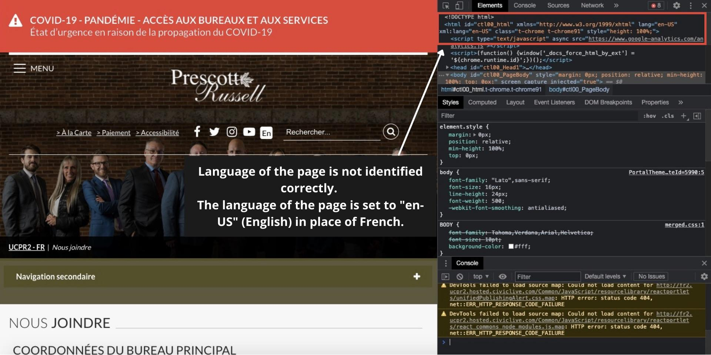
Issue: CFH-01-SR
The language of the page is identified incorrectly.
For the French pages the language is identified as “en-US” instead of “fr”.

Slide 108

Issue: CFH-02-OA
English headers and footers are used on
a few French pages.
Can be a template mapping mismatch.

Slide 109

Issue: SNH-01-SR
On-screen text is not set in the page language.
‘Skip Side Navigation’ appears as an English text on the French pages.

Slide 110

Issue: HFH-01-SR
On-screen/Off-screen text is not set in the page language.
The skip link appears as ‘Skip to content’.
The off-screen label for the breadcrumb landmark is set to ‘Breadcrumb’.
The off-screen label for the search input field is ‘Search’.
The off-screen H1 is set to ‘United Counties of Prescott and Russell’.
.
1.

Slide 111

Issue: HFH-01-SR
2.

Slide 112

Issue: HFH-01-SR
3.

Slide 113

Issue: HFH-01-SR
4.

Slide 114

Issue: SFH-01-OA
The page content and off-screen labels are all set in English language.

Slide 115

Issue: SFH-02-OA
The page header and
footer is set in English
language.

Slide 116

Issue: HPE-01-SR
The page has no level 1 heading.
Headings help organize the page content properly.

Slide 117



Issue: HPE-02-CC, HPE-04-ZM, HPE-05-ZM
The posts in the Instagram feed
overlap on each other.
This issue is observed intermittently
on 100% zoom.
Issue is quite evident and serious
at 2x and 4x zoom.

Slide 118

Issue: HPE-03-CC
Part of the image caption “2018 TO 2022 COUNCIL MEMBERS” has insufficient colour contrast.
CC value: 2.81:1 (white on light grey background).
Expected CC value: 3:1 (minimum).

Slide 119

Issue: HPE-06-KN
Scrollable content is not operable with keyboard.
The Instagram post modal has scrollable content, but there is no mechanism to scroll it using keyboard.

Slide 120

Issue: HPE-08-KN
Modal dialog does not fall next to the trigger control in the sequential navigation order.
Upon activating any of the Instagram posts, user needs to tab around 25 times to get his/her focus onto the rendered modal.
Till then the focus moves in the dimmed and obscured background.

Slide 121

Issue: HPE-11-SR
Links do not have an accessible name.
The ‘Previous’ and ‘Next’ links on the Instagram post modal do not have an accessible name.
They are just announced as ‘void(0) to the screen readers.

Slide 122

Issue: HPE-13-SR
Disabled state of the controls is not communicated to the assistive tech.
The ‘Previous’ and the ‘Next’ links on the Instagram post modal get dimmed upon reaching the first and the last post respectively.
This dimmed/disabled state is not communicated to the assistive technologies although it is evident visually.

Slide 123

Issue: HPE-14-SR
Aria-hidden elements contain focusable elements.
The ‘Close popup’ link on the Instagram post modal has aria-hidden property set to “true”.
Aria-hidden hides the text from screen readers.
Since the link
is focusable,
whenever the
screen reader
falls on it, it just
announces
“blank”.

Slide 124


Issue: HPE-07-KN
Infinitely loading social media feeds trap user focus.
Facebook and Twitter feeds load infinitely.
User cannot tab out of the feed panel unless the feed is over, which can take a long time.

Slide 125

Issue: HPE-10-SR
Page content not set in the page language.
A lot of page content including the text and CTAs under the social media feeds is not in the page language.
For any foreign language content the language needs to be programmatically set on the containing HTML element.

Slide 126

Issue: HPE-12-SR
Current selection is not available to the assistive tech.
The currently selected social media channel is evident visually, but this information is not made available to the screen readers.

Slide 127

Issue: HPE-15-SR
iFrame is not having an accessible name.
The iFrame containing the Facebook feeds has no accessible name associated to it.
This issue has a low user impact, but is an easy catch on automated accessibility tools. Thus is important from a legal perspective.

Slide 128

Issue: HPE-16-HV
Invalid aria attribute used.
Instagram feed posts use ‘aria-title’ which is not a valid aria attribute.
Thus the information communicated using this attribute will not the available.

Slide 129

Issue: HPE-09-SR
Labels for the slide navigation are not descriptive enough.
The off-screen labels are: ‘Previous’ and ‘Next’, and buttons with same labels are present for more than one slide widgets.
They can be ‘Previous Event’, ‘next Event’, etc.

Slide 130

Issue: HPE-17-SR
Non-actionable item has the role of a ‘button’.
The image caption which is a plain text and exhibits no action with click, has the role of a button thus creating the state of confusion for the users.

Slide 131

Issue: HPH-01-SR
Controls are not in page language.
The slide navigation controls ‘Previous’ and ‘Next’ have their names set in the English language.

Slide 132

Issue: HPH-02-SR
Links are not in the page language.
The ‘View on Instagram’ and ‘Close popup’ links on the Instagram post modal have their names in English on the French page.

Slide 133

Issue: STY-01-SR
Redundant alternative text.
The alt text for the card images match the text around them and thus cause a sense of redundancy.
These images can be decorative.
Not observed on the corresponding French page.

Slide 134

Issue: STY-02-SR
List not identified correctly.
The 6 card items under the ‘Quality of Life’ form a list.
They are identified as 2 lists of 3 items each.
Not observed on the corresponding French page.

Slide 135

Issue: STY-03-SR
The names for the 6 card items under the ‘Quality of Life’ heading are in French.
As per understanding these French words are not a part of regular English communication in the region.
Recommend to either change them to English alternatives or set the language to “fr” on
the containing
elements.
Not observed on
the corresponding
French page.

Slide 136

Issue: CUS-01-SR
Skipped heading levels.
H1 is followed by H3 ‘Main office information’ with no H2 in between.
Not observed on the corresponding French page.

Slide 137

Issue: TOM-01-KN
Link not operable with keyboard.
The link on card #4 – ‘VROUE & CHEW
ROAD TRIP” is not operable with keyboard.
All other links expand the corresponding
accordion.
This link is also not working on mouse click,
can be a mapping issue.

Slide 138
TESTING METHODOLOGY
Automated Accessibility Evaluation
Automated evaluation of web pages identifies accessibility issues that lend themselves easily to detection by software—for example, the absence of page code that provides alternative descriptions for images. Automated tools are also useful for detecting possible violations that must be verified by a skilled accessibility evaluator, by inspection or interaction with the web page.
Manual Accessibility Evaluation
In manual evaluation, an accessibility evaluator uses direct inspection and helper tools (such as special browser add-ons) to confirm issues found by automated tools, look for other issues that automatic tools cannot detect, and assess accessibility content for meaning and usability. For example, only a human evaluator can determine if a site can be fully navigated by keyboard alone, or if the alternative text for an image is a meaningful equivalent of that image, or if a table is a layout table or a data table.
(cont.)

Slide 139
TESTING METHODOLOGY (CONT.)
Assistive Technology Evaluation
In this method, an evaluator uses screen reader software (typically, JAWS from Freedom Scientific) to simulate the experience of visually impaired users. As the screen reader reads a web page out loud, the evaluator listens for the types of accessibility issues that screen reader users may experience.

Slide 140
ACCESSIBILITY TESTING IN A NUTSHELL
Manual & AT Testing | Automated Testing
Slower More accuracy If it is a very large site, only sample size can be tested End user test script can be followed Can assess robust applications ALL Success Criteria are checked | Faster False positives Guaranteed check of all links Cannot check all Success Criteria Content can be missed when automated user input is used More effective when Static content
Safest Method is Balance
Manual testing requires a precise systematic overview especially in case of larger sites making sure that all pages and elements are covered. Automatic testing can provide an initial assessment much faster, and give an idea of the accessibility of the site on a larger scale. However, it can not check for some very important issues, and should always be complemented with manual testing.

Slide 141
ACCESSIBILITY TESTING IN A NUTSHELL (1)
Manual & AT Testing
Slower
More accuracy
If it is a very large site, only sample size can be tested
End user test script can be followed
Can assess robust applications
ALL Success Criteria are checked
Automated Testing
Faster
False positives
Guaranteed check of all links
Cannot check all Success Criteria
Content can be missed when automated user input is used
More effective when Static content

Slide 142
ACCESSIBILITY TESTING IN A NUTSHELL (2)
Safest Method is Balance
Manual testing requires a precise systematic overview especially in case of larger sites making sure that all pages and elements are covered. Automatic testing can provide an initial assessment much faster, and give an idea of the accessibility of the site on a larger scale. However, it can not check for some very important issues, and should always be complemented with manual testing.

Slide 143
Demo

Slide 144
Q & A

Slide 145
W3C LICENCING INFORMATION
Copyright © 2015 W3C® (MIT, ERCIM, Keio, Beihang). This software or document includes material copied from or derived from Web Content Accessibility Guidelines (WCAG) 2.1.
Copyright © 2017-2018 W3C® (MIT, ERCIM, Keio, Beihang). W3C liability, trademark and document use rules apply. W3C liability, trademark and document use rules apply.
Document Status

